Slide 1
ANOVA
Comparing >2 groups

Slide 2
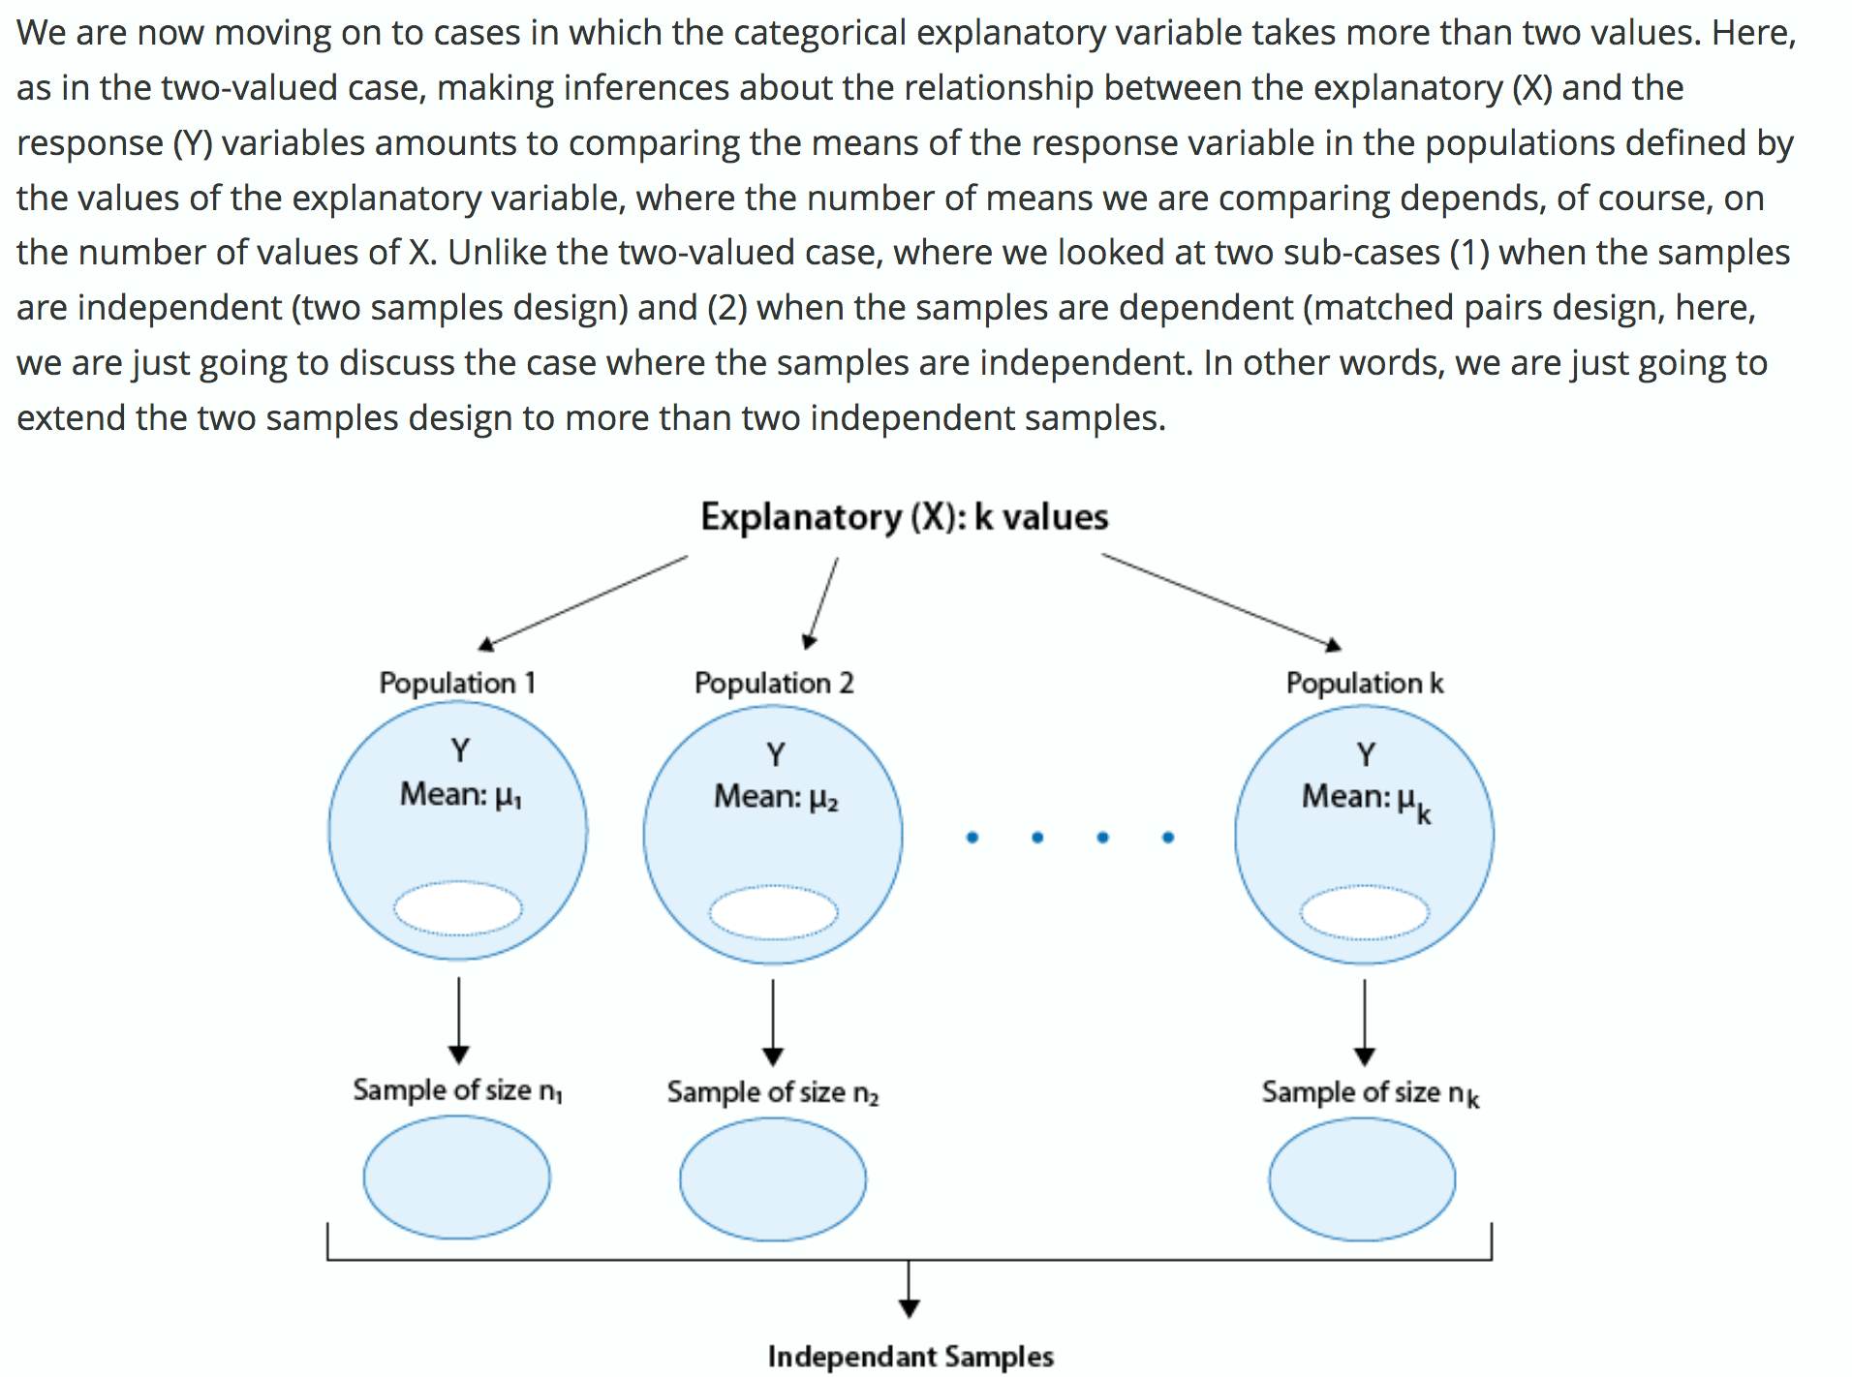
Notes:
https://lagunita.stanford.edu/courses/OLI/ProbStat/Open/courseware/inference_relationships_cq/_m4_anova/
unit 1

Slide 3
ANOVA - analysis of variance
Tests whether any two of N means are unequal
H₀ : μ₁ = μ₂ = μ₃ ... = μ_{N}
H_{A} : at least one pair of μ's are unequal
Uses F statistic:
Notes:
https://lagunita.stanford.edu/courses/OLI/ProbStat/Open/courseware/inference_relationships_cq/_m4_anova/
unit 4

Slide 4
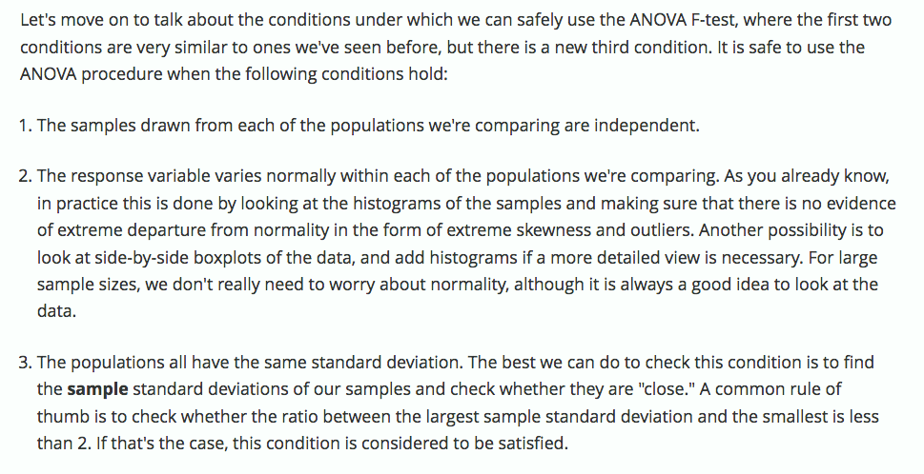
When you can use ANOVA F-test
Notes:
https://lagunita.stanford.edu/courses/OLI/ProbStat/Open/courseware/inference_relationships_cq/_m4_anova/
unit 4

Slide 5
Practice: eye color & monitor flicker

Slide 6
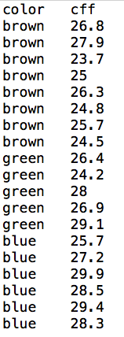
Data (from paper)
explanatory variable is eye color
response variable is CFM
threshold where flicker detected
Use aov function in R to answer:
Is there a difference?

Slide 7
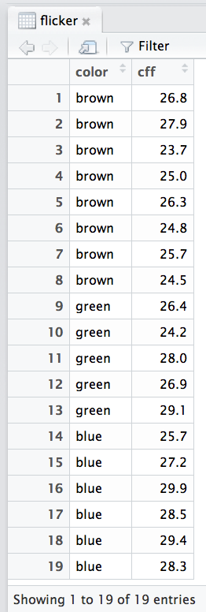
Get data from Canvas
Click "Agenda" link for today to download "flicker.txt"
Load data into R
tip: You can use Tools > Import Dataset menu

Slide 8
State null & alternative hypothesis
H₀ - means are the same
μ_{brown} = μ_{green} = μ_{blue}
H_{A} - at least two of the means are different
Note: don't need to hypothesize which are different or how

Slide 9
In R, use aov function
Use "~" (tilde) formula operator to relate explanatory and response variables
explanatory variable second
response variable comes first
tells function which data to use
Can read it as: "cff follows color"
Save result to a variable

Slide 10
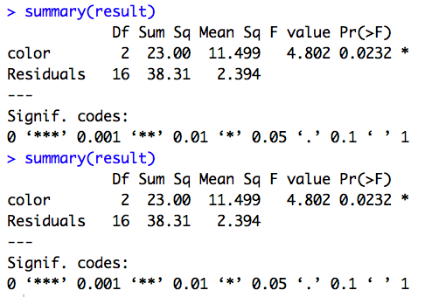
Use summary to view result
Probability of obtaining an F statistic of 4.802 or larger assuming null hypothesis is true: 0.0232.

Slide 11
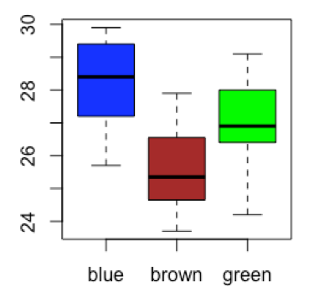
Use boxplot or histograms to check assumptions
Note: can use same syntax as with aov
Look for:
outliers
skew

Slide 12
Calculating standard deviation for the three eye colors
Different ways to do it...both fine

Slide 13
Are conditions that allow us to safely use the ANOVA F-test met?
Notes:
https://lagunita.stanford.edu/courses/OLI/ProbStat/Open/courseware/inference_relationships_cq/_m4_anova/
unit 7

Slide 14
Questions
What conditions have to be satisfied to use F test (anova)?
Do groups need to be the same size?
What if you already suspect one group has larger or smaller mean compared to the others. Does ANOVA let you take this into account?

