Slide 1
Using R built-in distribution functions to solve sample mean problems
Examples from Stanford OLI ProbStat reading

Slide 2
Problem
You have data from a random sample and want to estimate a population mean within a tolerance.
You know a population mean and want to find out how unlikely a given sample mean is
How?

Slide 3
Use central limit theorem
View sample mean and sample proportion as random variables
Your sample's mean (or proportion) is one realization of that random variable
Both are normally distributed with
mean equal to population mean or proportion
standard deviation equal to population standard deviation divided by square root of sample size

Slide 4
Using CLT - sample mean
If μ is population mean, σ is population standard deviation, N is sample size
then sample mean is normally distributed with mean μ and standard deviation σ/sqrt(N)
This lets you estimate population mean using sample mean

Slide 5
Using CLT - sample proportion
If p is population proportion and N is sample size
Population standard deviation is sqrt(p*(1-p))
Sample proportion is normally distributed with mean p and standard deviation sqrt(p*(1-p)/N)
This lets you estimate population mean using sample mean

Slide 6
dnorm
qnorm
rnorm
pnorm

Slide 7
http://seankross.com/notes/dpqr/
Read it now...

Slide 8
Distribution functions in R - dnorm, pnorm, qnorm, rnorm
dnorm - density function; for a given x, find the corresponding y value on the normal curve
use it to plot normal curves

Slide 9
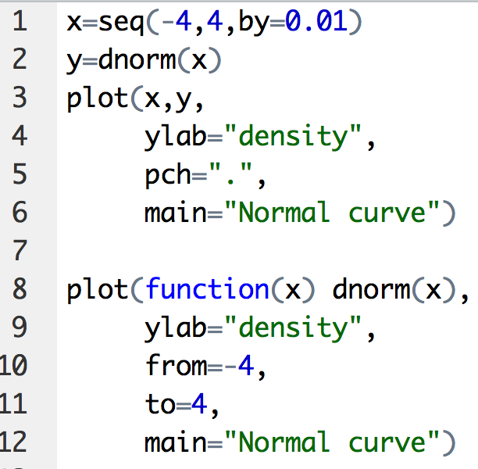
Can use dnorm to plot normal curves
dnorm - density function; for a given x, find the corresponding y value on the normal curve

Slide 10
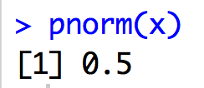
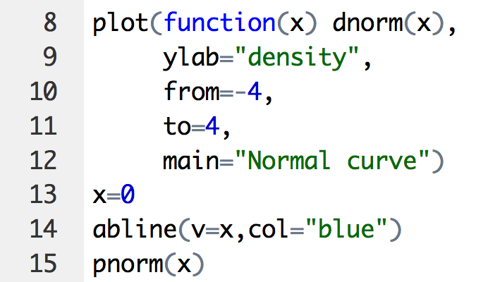
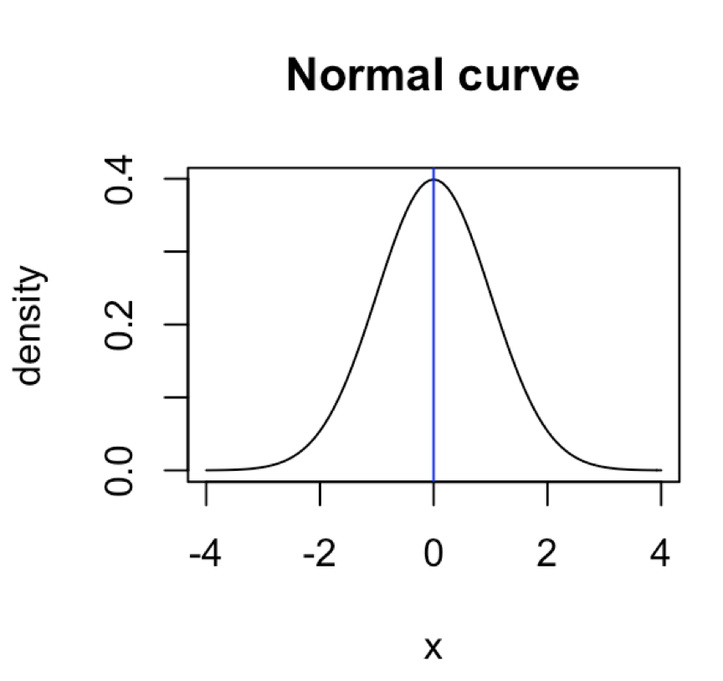
pnorm - cumulative distribution function finds P(X< x), area under curve to the left of x

Slide 11
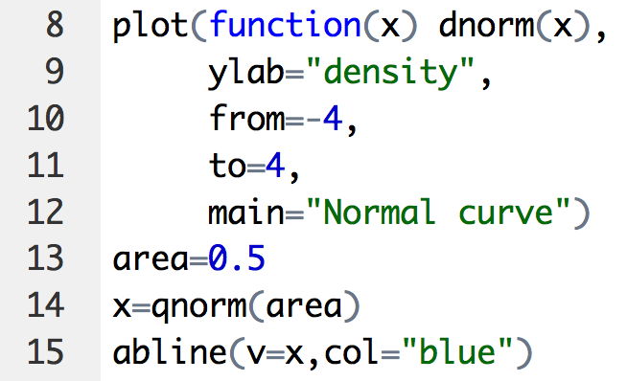
qnorm - finds x value immediately to the right of given area

Slide 12
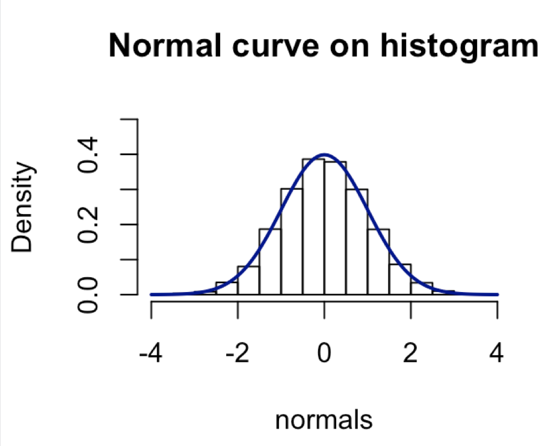
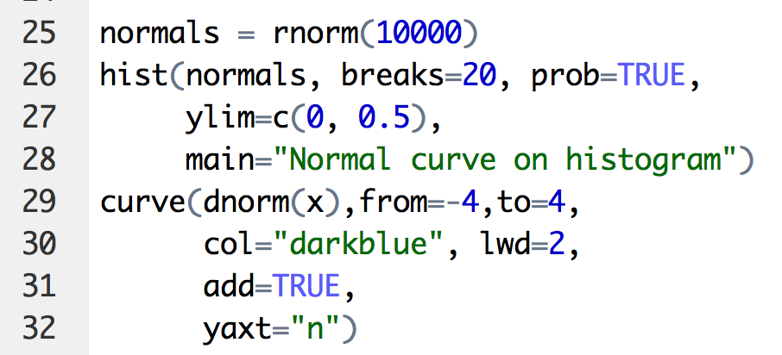
rnorm - simulate taking a random sample from the normal distribution

Slide 13
There are other "dpqr" functions for other distributions
Use help to get info

Slide 14
How to solve CLT-related problems
Draw normal curve
Add vertical lines
mean or sample proportion
threshold lines
Shade relevant area
Pick R function
pnorm if finding area
qnorm if finding x value (location of vertical lines)
Define variables:
standard deviation
mean/proportion
test parameter
Run R function
Check result using inverse
dnorm if used qnorm
qnorm is used dnorm
Problem-solving tip: First draw the problem. This will give you insight!

Slide 15
Adult male height (X) follows (approximately) a normal distribution with a mean of 69 inches and a standard deviation of 2.8 inches.
What proportion of males are less than 65 inches tall? In other words, what is P(X < 65)?
from Stanford OLI reading: Probability: Continuous Random Variables > Normal Random Variables > Statistics Package Exercise: Using the Normal Distribution

Slide 16
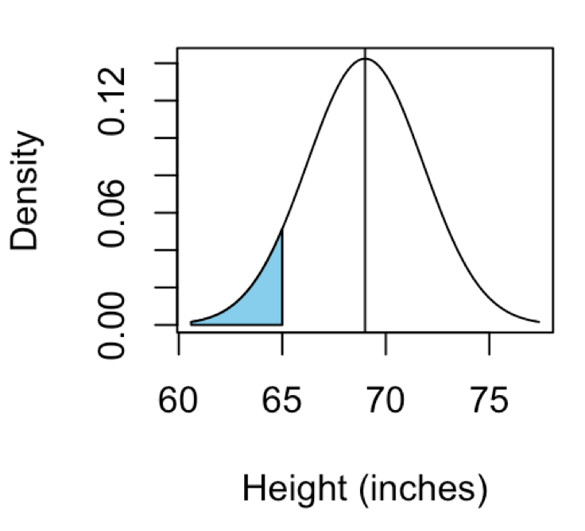
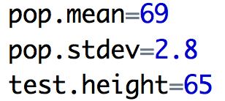
1,2,3 - draw, add lines & shading
5 - define function arguments: standard deviation & mean & test parameter
6 - run function
7 - run inverse to check result
4 - pick a function - pnorm or dnorm.
You know X , want area (blue) under curve.
Use pnorm (not qnorm)

Slide 17
Adult male height (X) follows (approximately) a normal distribution with a mean of 69 inches and a standard deviation of 2.8 inches.
(b) What proportion of males are more than 75 inches tall? In other words, what is P(X > 75)?
You solve it
from Stanford OLI reading: Probability: Continuous Random Variables > Normal Random Variables > Statistics Package Exercise: Using the Normal Distribution

Slide 18
Adult male height (X) follows (approximately) a normal distribution with a mean of 69 inches and a standard deviation of 2.8 inches.
(c) What proportion of males are between 66 and 72 inches tall? In other words, what is P(66 < X < 72)?
You solve it
from Stanford OLI reading: Probability: Continuous Random Variables > Normal Random Variables > Statistics Package Exercise: Using the Normal Distribution

Slide 19
A random sample of 100 students is taken from the population of all part-time students in the United States, for which the overall proportion of females is 0.6.
There is a 70% chance that the sample proportion falls between what two values?
You solve it
adapted from Stanford OLI reading: Probability: Sampling Distributions > Sample Proportion > Behavior of Sample Proportion: Applying the Standard Deviation Rule
Notes:
The true population proportion is 0.6
The population standard deviation is sqrt(0.6*(1-0.6/100)) =sqrt(0.024)
The sample proportion is normally distributed with mean 0.6 and standard deviation

Slide 20
The proportion of left-handed people in the general population is about 0.1. Suppose a random sample of 225 people is observed.
What is the probability that 40 or more people in the sample are left-handed?
You solve it
adapted from Stanford OLI reading: Probability: Sampling Distributions > Sample Proportion > Behavior of Sample Proportion: Applying the Standard Deviation Rule
Notes:
The true population proportion is 0.6
The population standard deviation is sqrt(0.6*(1-0.6/100)) =sqrt(0.024)
The sample proportion is normally distributed with mean 0.6 and standard deviation

