Slide 1
Point Estimators & Confidence Intervals
Review of concepts from Stanford OLI ProbStat Reading

Slide 2
Point estimators - mean and proportion
Unbiased: The point estimator fluctuates randomly around the population's value. Half the time, it's larger. Half the time, it's smaller.
from: Inference: Estimation > Estimation: Point Estimation > Point Estimation: Unbiased Estimators

Slide 3
Use CLT to define confidence intervals for point estimators
from: Inference: Estimation > Estimation: Point Estimation > Interval Estimation

Slide 4
Goal: Know how to calculate a confidence interval
For point estimator of population mean - μ
For point estimator of population proportion - p
How?
Use Central Limit theorem: sample means and sample proportions (under certain conditions) are normally distributed
Use pnorm, qnorm functions in R

Slide 5
from: Inference: Estimation > Estimation: Population Proportion > Confidence Intervals for Population Proportion p: Margin of Error

Slide 6
Remember: How to solve CLT-related problems
Draw normal curve
Add vertical lines
mean or sample proportion
threshold lines
Shade relevant area
Pick R function
pnorm if finding area
qnorm if finding x value (location of vertical lines)
Define variables:
standard deviation
mean/proportion
test parameter
Run R function
Check result using inverse
dnorm if used qnorm
qnorm is used dnorm
Problem-solving tip: First draw the problem. This will give you insight!

Slide 7
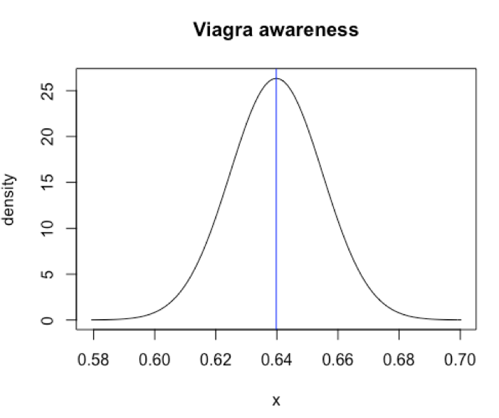
We want to find x₁ and x₂ that "carve out" 95% of the area under the curve
? x₁
? x₂

Slide 8
We want to find x₁ and x₂ that "carve out" 95% of the area under the curve
Pick R function:
pnorm or qnorm?
? x₁
? x₂

Slide 9
We want to find x₁ and x₂ that "carve out" 95% of the area under the curve
This area is (1-0.95)/2
This area is (1-0.95)/2
? x₁
? x₂

Slide 10
Take-home message: Use sample standard deviation to estimate population standard deviation
p is population proportion
Remember standard deviation of sample proportion is:
Because N*p > 10 and N*(1-p) > 10, we can assume that the sample proportion is normally distributed.
...we don't know population proportion; that's what we're trying to estimate!=
To overcome this, we replace p with its sample counterpart...
the standard error of p-hat

Slide 11
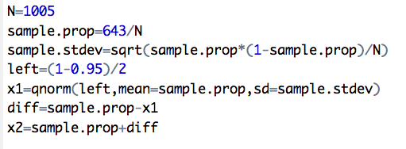
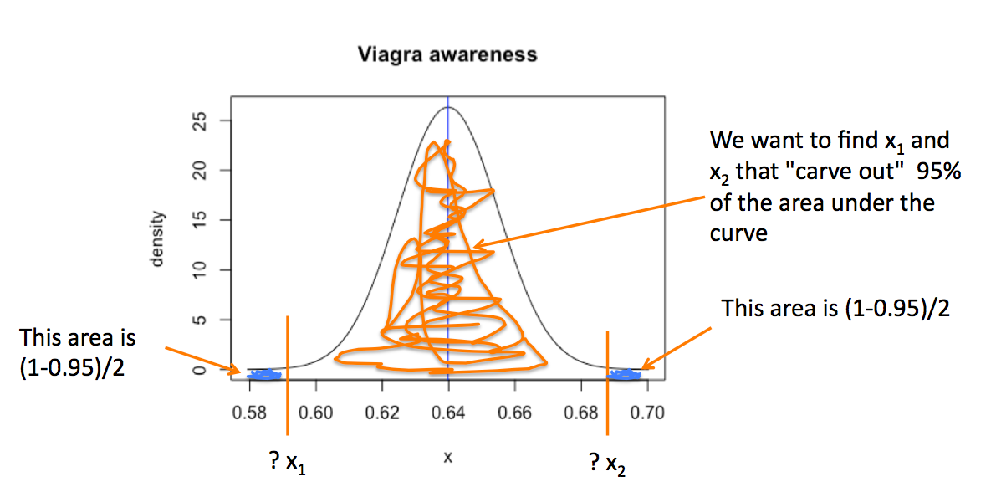
Continuing...
Pick R function
pnorm if finding area
qnorm if finding x value (location of vertical lines)
Define variables:
standard deviation
mean/proportion
test parameter
Run R function
Check result using inverse
dnorm if used qnorm
qnorm is used dnorm

Slide 12
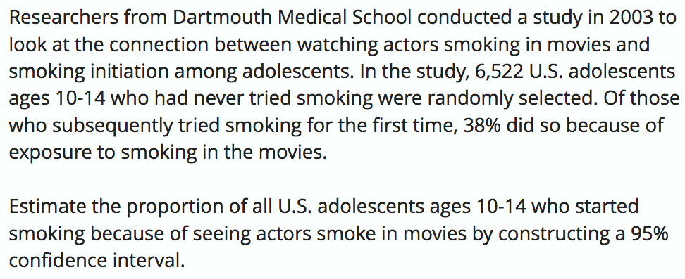
Practice - you solve it
From: Inference: Estimation > Estimation: Population Proportion > Confidence Intervals for Population Proportion p: Margin of Error

Slide 13
Practice - confidence interval for population mean - μ
What's the standard deviation for a sample mean?
Use standard error of the mean (if don't know population standard deviation)
Hint: recall Central Limit Theorem

Slide 14
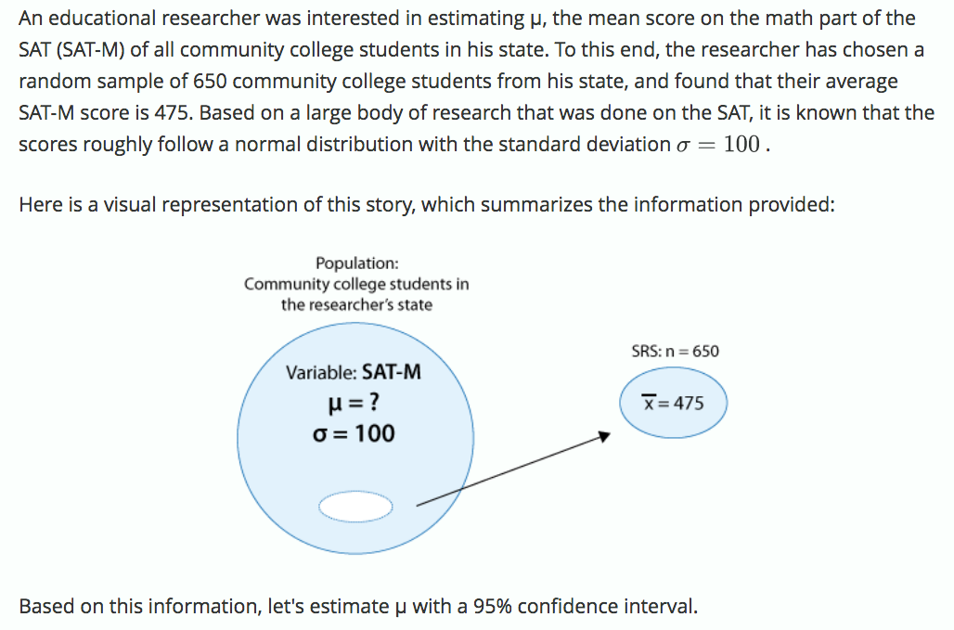
Practice - you solve it

Slide 15
Practice - You solve it
The Golden Retriever Club of America conducted a study of 64 golden retrievers, and found the average age at death in the sample to be 11.0 years old. Let’s assume the standard deviation of golden retriever lifespan is known to be 1.2 years (this is consistent with studies and with some other dog breeds). Give three confidence interval estimates for the unknown mean age at death for golden retrievers: first using 90% confidence, then 95%, and finally 99%. Please report your intervals in parenthesis notation, and please round your final values to the nearest tenth for simplicity. Be sure to notice the size of the intervals with the different confidence levels.
From: Inference: Estimation > Estimation: Population Mean > Confidence Intervals for the Population Mean: Other Levels of Confidence

