Slide 1
Comparing groups
Background for ProbStat Inference II Quiz

Slide 2
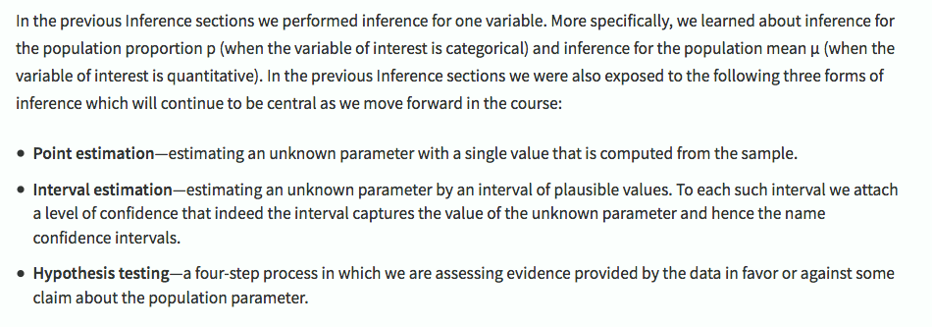
Inference: Relationships C→Q > Case C→Q > Inference for Relationships Introduction
Z test

Slide 3
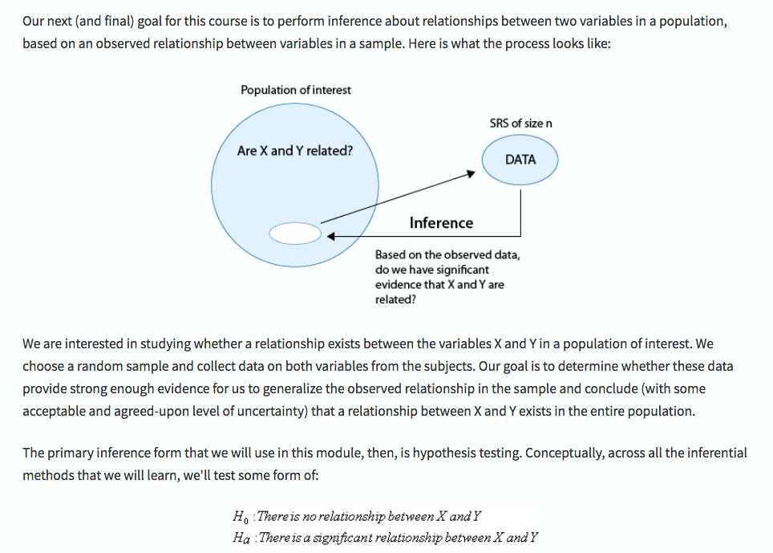
Inference: Relationships C→Q > Case C→Q > Inference for Relationships Introduction

Slide 4
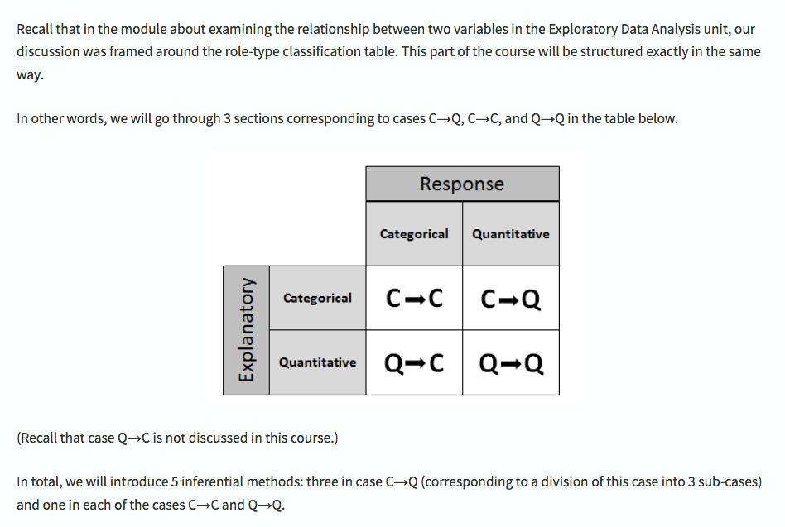
Inference: Relationships C→Q > Case C→Q > Inference for Relationships Introduction
two-sample t test, unpaired
two-sample t test, paired
ANOVA (for many samples)
linear regression
Covering just these in this class

Slide 5
Comparing groups - how to
Read the study description, define the means, values you need to compare
State null and alternative hypotheses
Pick a test & R function to run the test
Pick an α (p value) significance level
Get the data
do EDA
reformat (if required)
check test assumptions (pick a new test if required)
Run the test
Report the conclusion
p value > α, don't reject the null
p value < α, reject the null & accept alternative

Slide 6
Examples
Statistics package exercises from the Stanford OLI course reading

Slide 7
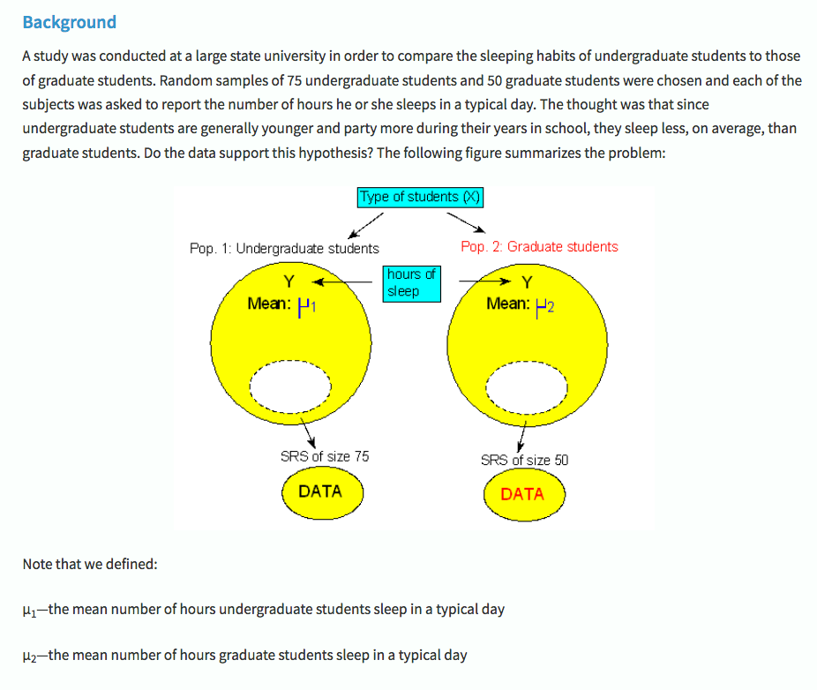
Inference: Relationships C→Q > Two Independent Samples > Statistics Package Exercise: Carrying Out the Two-Sample t-test

Slide 8
1. Read study, define the means, 2. Define hypotheses
H₀ - μ₁ = μ₂
H_{A} - ???
"The thought was that since undergraduate students are generally younger and party more during their years in school, they sleep less, on average, than graduate students. "
Inference: Relationships C→Q > Two Independent Samples > Statistics Package Exercise: Carrying Out the Two-Sample t-test

Slide 9
3. Pick a test & R function
Two independent samples
t test, unpaired
Two matched samples
t test, paired
> two samples
ANOVA
quantitative explanatory & response variables
linear regression
Which should you pick?

Slide 10
4. Pick an α (significance level)
Whatever value you select should fit the power of the study and your expectations.
If you're not sure, 0.05 is a good default.

Slide 11
5. Download the data
Go to
Inference: Relationships C→Q > Two Independent Samples > Statistics Package Exercise: Carrying Out the Two-Sample t-test
Follow instructions to download & load the data into R
Do EDA, reformat if required
Check test assumptions (pick new test if required)

Slide 12
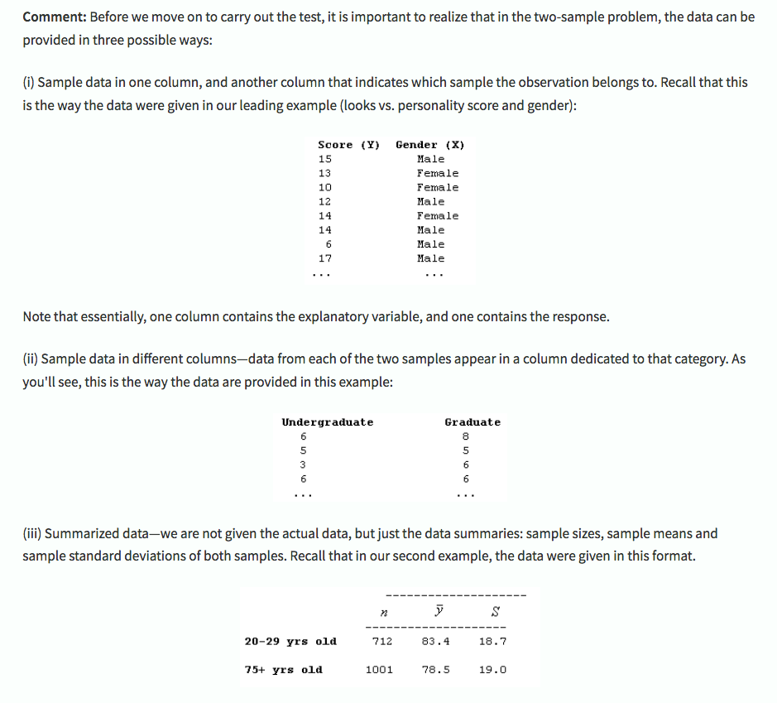
About the data - from the reading

Slide 13
6. Run the test
Tip!
To choose option for "alternative, make a sentence:
"undergraduate" is "less" than "graduate"
first argument
alternative
second argument

Slide 14
7. Report the conclusion
Save the output to a variable:
result = t.test(...)
Use summary or $ operator to retrieve test statistic, confidence intervals, p value, etc
State whether you have enough evidence to reject the null:
Is p value < α?

