Slide 1
Inference - One-sample t test

Slide 2
T test useful when you don't know population standard deviation
Notes:
https://lagunita.stanford.edu/courses/OLI/ProbStat/Open/courseware/inference_hyp_testing_mean/hyp_testing_for_mean_t_test/

Slide 3
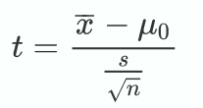
How to use a one-sample t test
Check: Can you use it? Are conditions satisfied?
Is sample random? Is variable normally distributed?
Propose null (H₀) hypothesis
H₀: μ = some number
Propose alternative hypothesis (H_{A})
one sided (two options)
μ > some number
μ < some number
two sided:
μ ≠ some number or p ≠ some number
Calculate t test statistic
Determine probability of obtaining t as extreme assuming H₀ is true
need to consider degrees of freedom; t distribution depends on N

Slide 4
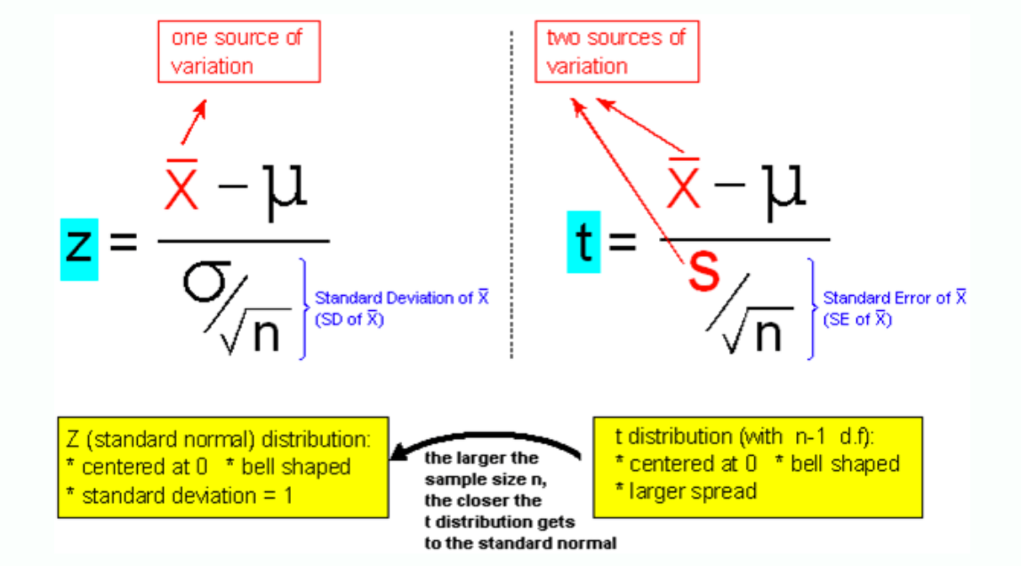
Comparing Z and t
Notes:
https://lagunita.stanford.edu/courses/OLI/ProbStat/Open/courseware/inference_hyp_testing_mean/hyp_testing_for_mean_t_test/
section 2

Slide 5
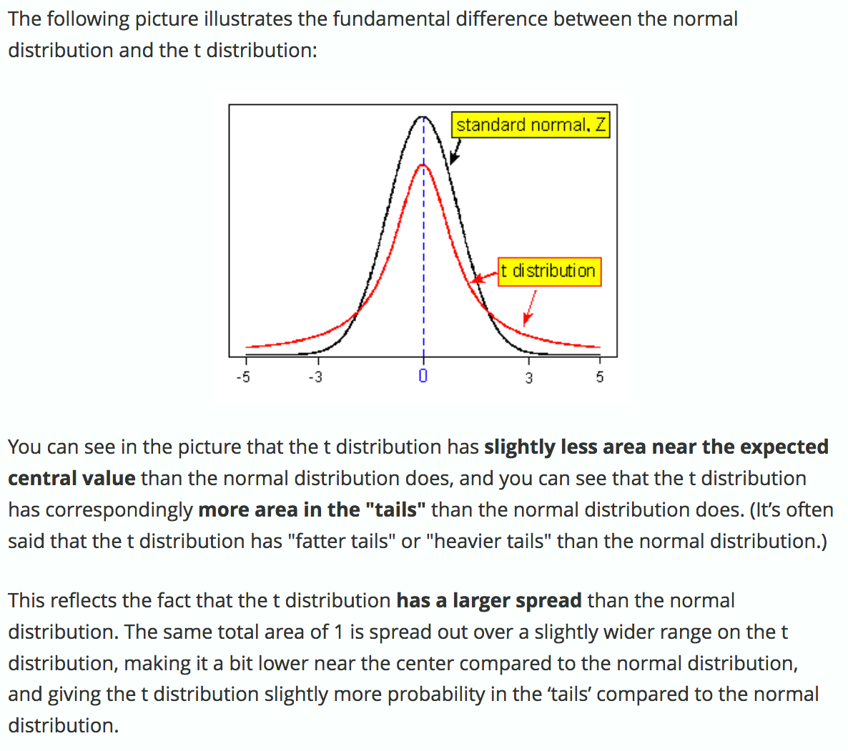
T distribution bell shaped, but longer tails
Notes:
https://lagunita.stanford.edu/courses/OLI/ProbStat/Open/courseware/inference_hyp_testing_mean/hyp_testing_for_mean_t_test/, first module

Slide 6
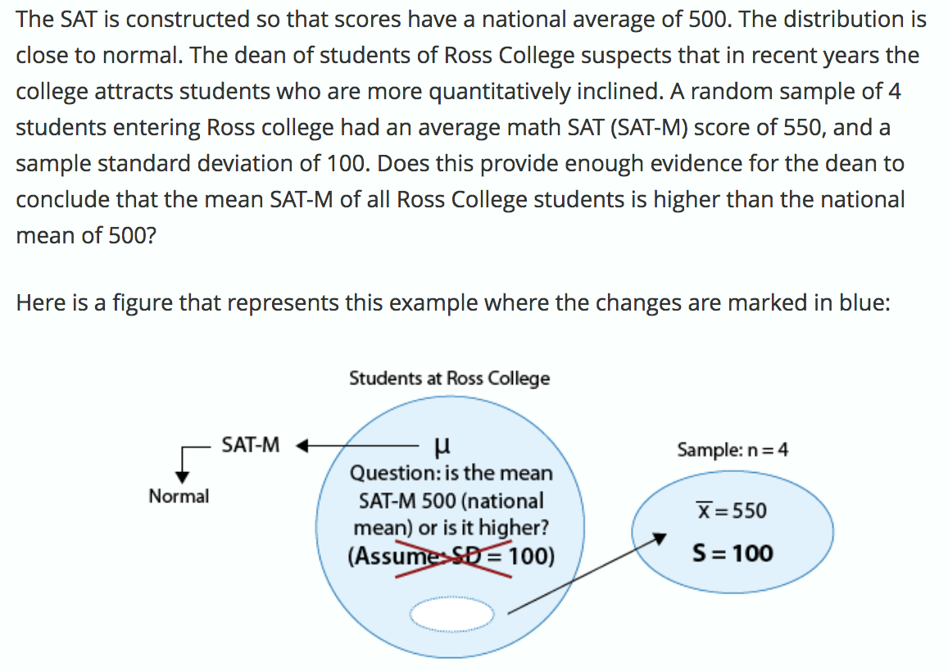
Example - one-sample t-test: Ross students have higher SAT scores?

Slide 7
Example - one-sample t-test: SAT scores
Can we use t-test? Yes.
Construct hypotheses:
H0: μ = 500, where μ is the mean SAT score of Ross students
HA: μ > 500
Calculate t:
Determine p value, probability of obtaining a test statistic this extreme assuming the null hypothesis is true

Slide 8
Example - one-sample t-test: SAT scores
Find p value using null distribution of test statistic

Slide 9
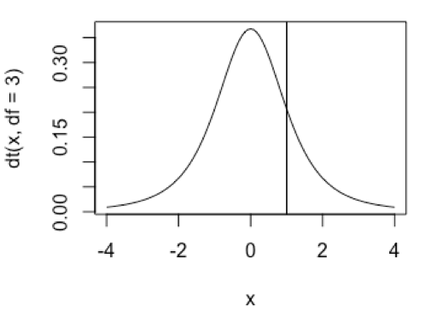
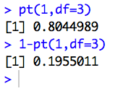
Using R - one-sample t-test
Draw the plot, showing location of t
Find probability of t = 1 or larger
p value is 0.195
Notes:
http://www.statmethods.net/advgraphs/probability.html
http://stackoverflow.com/questions/24456890/generate-t-distribution-density-plot-with-pre-specified-mean

Slide 10
Notes:
https://lagunita.stanford.edu/courses/OLI/ProbStat/Open/courseware/inference_hyp_testing_mean/hyp_testing_for_mean_t_test/
second-to-last section

Slide 11
Example - one-sample t test: Using t.test in R
The Intel Corporation is conducting quality control on its circuit boards. Thickness of the manufactured circuit boards varies unavoidably from board to board. Suppose the thickness of the boards produced by a certain factory process varies normally. The distribution of thickness of the circuit boards is supposed to have the mean μ = 12 mm if the manufacturing process is working correctly. A random sample of five circuit boards is selected and measured.
Values are: 8.08, 11.50, 7.84, 10.18, 8.45
Do the boards vary significantly from intended mean of 12 mm?

Slide 12
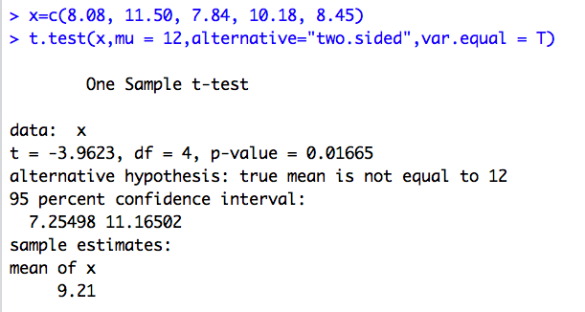
Example: Using t.test in R
H₀: μ = 12.00 mm, where μ is mean of board thickness
H_{A}: μ ≠ 12.00 mm

Slide 13
Practice - you solve it
The Intel Corporation is conducting quality control on its circuit boards. Thickness of the manufactured circuit boards varies unavoidably from board to board. Suppose the thickness of the boards produced by a certain factory process varies normally. The distribution of thickness of the circuit boards is supposed to have the mean μ = 12 mm if the manufacturing process is working correctly. A random sample of five circuit boards is selected and measured.
Values are: 10.32, 12.17, 12.88, 12.90, 10.13
Do the boards vary significantly from intended mean of 12 mm?

