Slide 1
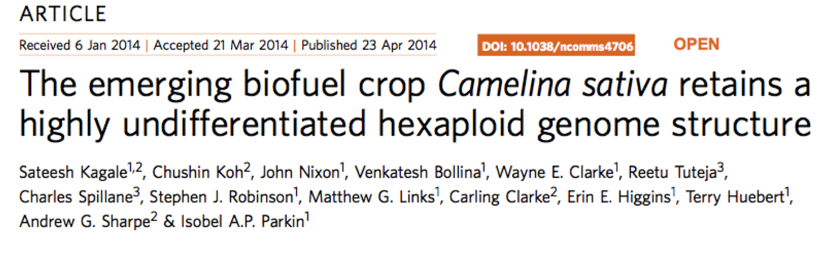
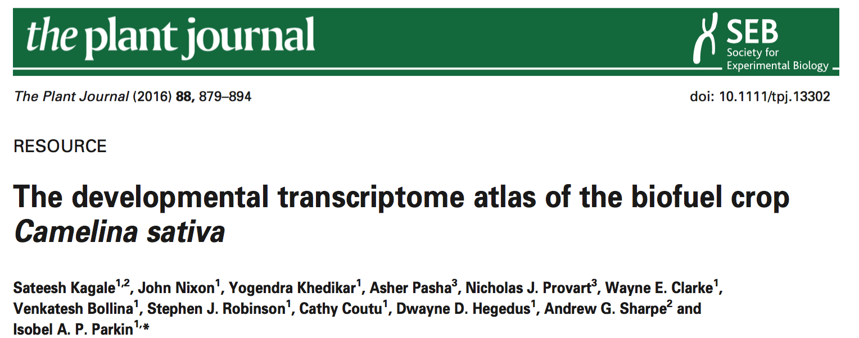
Today: using published genome & mRNA-Seq data from...
Data from 12 sample types:
  Young & old leaf
  Stem, Root
  Bud, flower
  Five seed stages
3 replicates per sample type
Notes:
The data used today come from two papers. The RNA-Seq data set first was introduced in the Camelina genome paper (top). They mainly used it to inform annotation - to identify genes and gene structures. The also examined the very interesting question of how genes from the three sub-genomes of Camelina are expressed. The authors then performed a more in-depth analysis of the transcriptome. If you read the article (bottom) you'll see that they used a very different pipeline from what you'll learn today. This is perfectly fine, and it highlights how the computational biologist has many methods and approaches to choose from. But it also highlights how important it is to document and record your work. Each choice and approach needs to be recorded carefully so that you can understand how these choices may affect the downstream analysis.

Slide 2
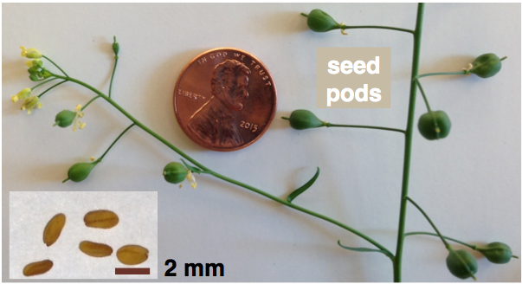
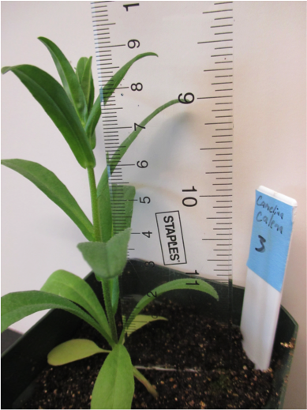
Camelina sativa
Model oilseed crop
  Similar to Arabidopsis
  Easy & cheap to grow
  Seed to seed in ~2 months
  Transformable via floral dip
  DS-Red visual marker for screening transgenic seeds
Interesting biology
  Hardy, adapted to cold, arid climate
  Hexaploid ("Arabidopsis times 3")
Grown for its oil since ancient times, many emerging uses
  biodiesel, jet fuel, lubricants
  plant-based platform for pharmaceuticals
  animal feed supplement, esp. aquaculture
  high in omega-3 FAs, vitamin E
  specialty oil for human & animal consumption, skin care

Slide 3
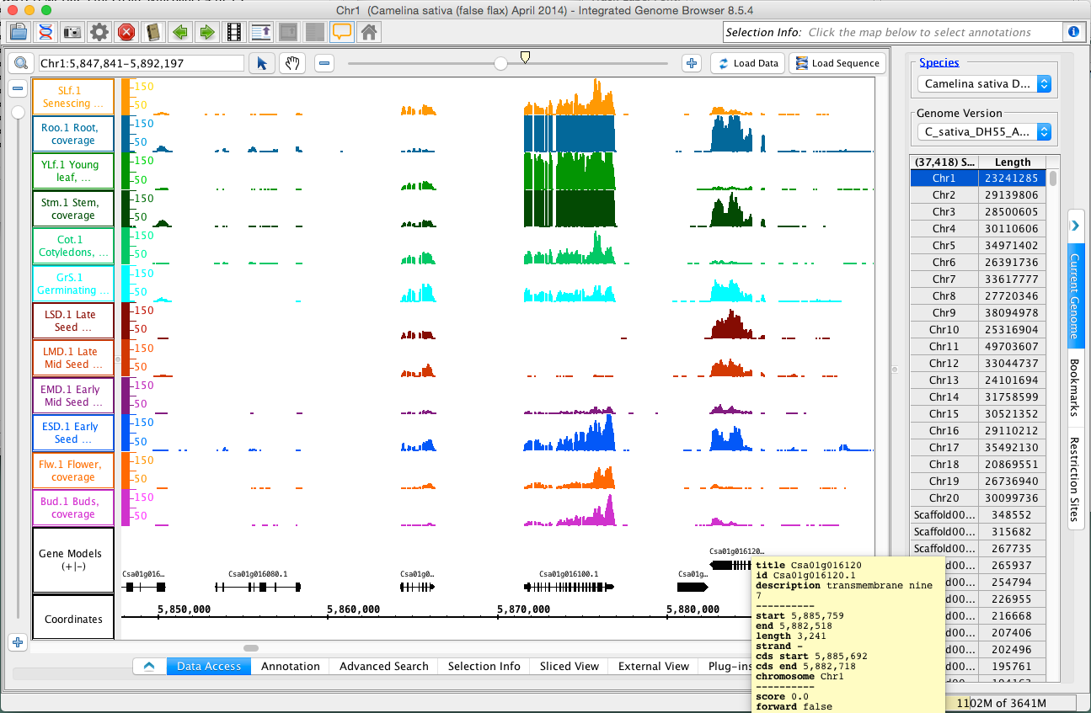

mRNA-Seq data in Integrated Genome Browser (bioviz.org)
coverage graphs
Each row is called a "track"
One library/track
Y-axis is number of reads/base
Data not normalized, can use nearby genes to calibrate visually

Slide 4

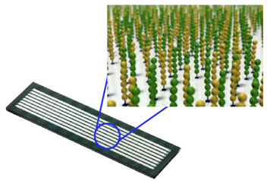
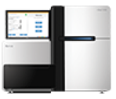

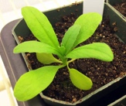


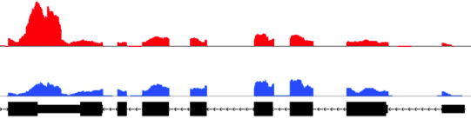
mRNA-Seq = high throughput sequencing of cDNA
Plan experiment
Biological replication
Sequencing strategy
Data analysis strategy
sequence by synthesis
Data, fastq sequence files
Millions of reads
per library
1. Design
prepare flowcell
collect samples
library
reflects RNA from original sample
3. Sequence Libraries
quality assessment
extract RNA, purify polyA+
map to genome
~
~
~
amplify
~
count reads per gene
ligate adapters
fragment
-
-
identify
differential expression
-
-
-
-
-
-
-
-
-
add “A” bases to 3’ ends
synthesize cDNA
(random hexamers)
-
repair
ends
-
-
-
visualize
counts
-
-
-
-
-
-
-
-
-
-
-
-
-
-
-
-
-
-
-
-
-
-
-
-
-
-
2. Make Libraries
4. Analyze Data
Notes:
Stock photo image (upper left) from http://agiletools.wordpress.com/2008/09/10/10-different-ways-to-run-a-planning-meeting/
Arabidopsis image from Loraine Lab
Flowcell image (middle) from http://www.giga.ulg.ac.be/jcms/prod_26859/illumina-genome-analyser-sequencing-technology-how-it-works
HiSeq

Slide 5
Read 1 and Read 2:
Reverse complements from the same mRNA fragment
Read 1
Index
Read 2

Slide 6
Paired end sequencing produces
2 FASTQ files with millions of records
Read
1
1
Read
2
2
Tip: Use FastQC to visualize quality score distribution per base
    Line 1 – name, starts with @
    Line 2 – sequence
    Line 3 – can contain anything, starts with +
    Line 4 – quality scores
FASTQ
record
Notes:
Here is an example of two records from a fastq file for read 1 and another fastq file for read 2 of the same fragment. The first line has the read identifier and a second section of text that indicates whether the record is from read 1 or read 2. The second line contains the sequence and the fourth line contains the per-base quality scores. The quality scores typically range from 0 to 41, with 41 being the highest quality. The quality scores are encoded using a system that connects characters with quality scores. Also, it's important to understand that read1 and read2 are sequences taken from the opposite strands of the same library molecule. This means that the pair of reads represents one molecule, or one count.
Reference:
The Sanger FASTQ file format for sequences with quality scores, and the Solexa/Illumina FASTQ variants.
http://www.ncbi.nlm.nih.gov/pubmed?term=20015970

Slide 7
Next: Map reads to genome using tophat2 (or other spliced aligner) and count fragments per gene (pairs)
(.fastq)
FASTQ
genome
(.fa)
Other pipelines are possible.
tophat2
gene annotations
binary sequence
alignment map
(.bed)
(.bam)
featureCounts
counts per gene
(.txt)
edgeR
differentially expressed genes
(.txt)

Slide 8

Goal: Find differentially expressed genes in giant table of counts per gene, where rows are genes & columns are samples
Libraries were sequenced to different depths.
But even so, you can notice expression differences.
One "count" is a pair - Read1 and Read2 sequenced from the same library molecule.

Slide 9
Goals for today, next week
Part I - R refresher
  Lists, data frames, $ operator
Part 2 - Find differentially expressed (DE) genes
  Read data
  Use edgeR to find DE genes
  Explore results using RStudio & subscripting
  Introduce data analysis assignment:
    Compare different samples types
Part 3 - Visualize RNA-Seq data (sanity-check results)

Slide 10
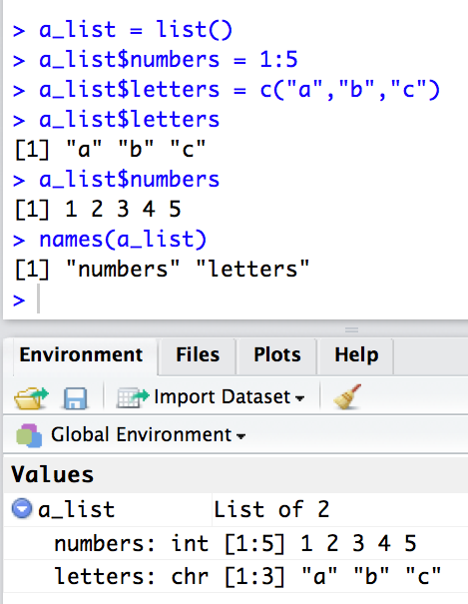
A list is a general-purpose container for other objects
The list command makes a new list
New: Use dollar operator $ to assign or retrieve items from a list by name
Use the Environment tab or names command to find out what a list contains

Slide 11
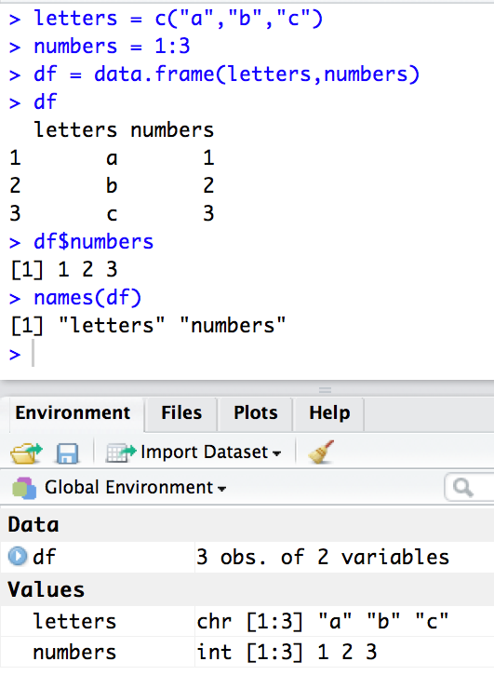
A data frame is a list with rows & columns
It's like a matrix
  Rows must be the same length
  Columns must be the same length
The data.frame command makes data frames
Use dollar operator $ to retrieve columns as vectors or assign new values
    df$numbers=4:6
    df$numbers[1]=2
    df$numbers[1:2]=c(3,1)
Use the Environment tab or names command to find out what columns a data frame contains

Slide 12
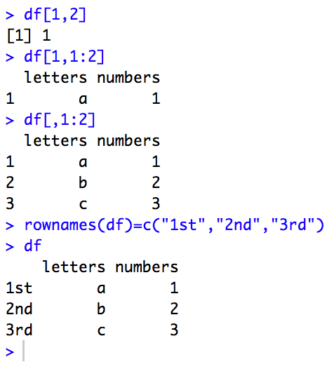
Use [] to get data from a data frame - just like with a matrix
Uses same syntax as for a matrix
  Subscripting accepts
    single values
    vectors
Assign names to rows using rownames
Tip: use logical vectors to extract rows that satisfy a condition:
  Example - retrieve rows where numbers column > 1
df[df$numbers>1,]

Slide 13
Data frame and list ideas coming up in the Differential Expression section
Lists can contain anything
  vectors, matrices, data frames, other lists
  Bioconductor makes heavy use of list-based objects to store results from statistical testing
    DGEList, DGELRT
Data frames mainly used to store and manage data imported into R from files
  use read.delim (or similar) commands to read data from files into data frames

Slide 14
Find differentially expressed (DE) genes in RNA-Seq data
Learn how to
  Read data, make plots
  Use edgeR to find DE genes
  View in RStudio
Activity:
    Compare samples types

Slide 15
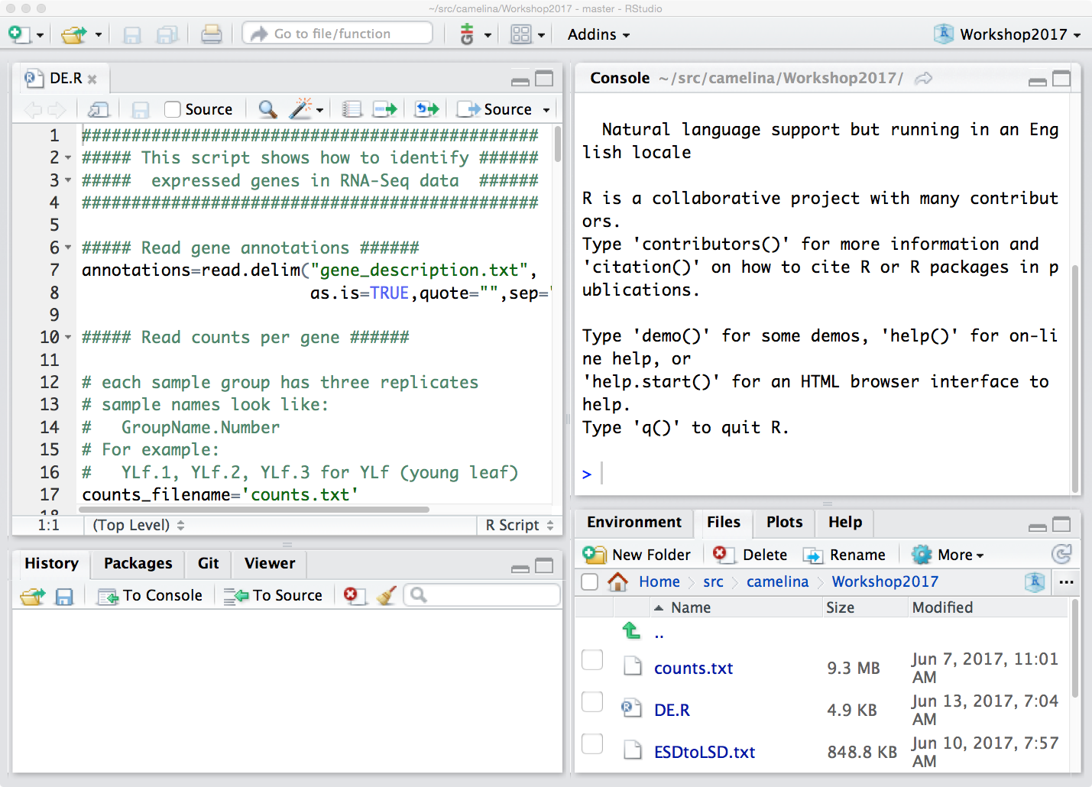

Open R script for: DE.R
File opens in Editor
Select File DE.R in Files tab

Slide 16
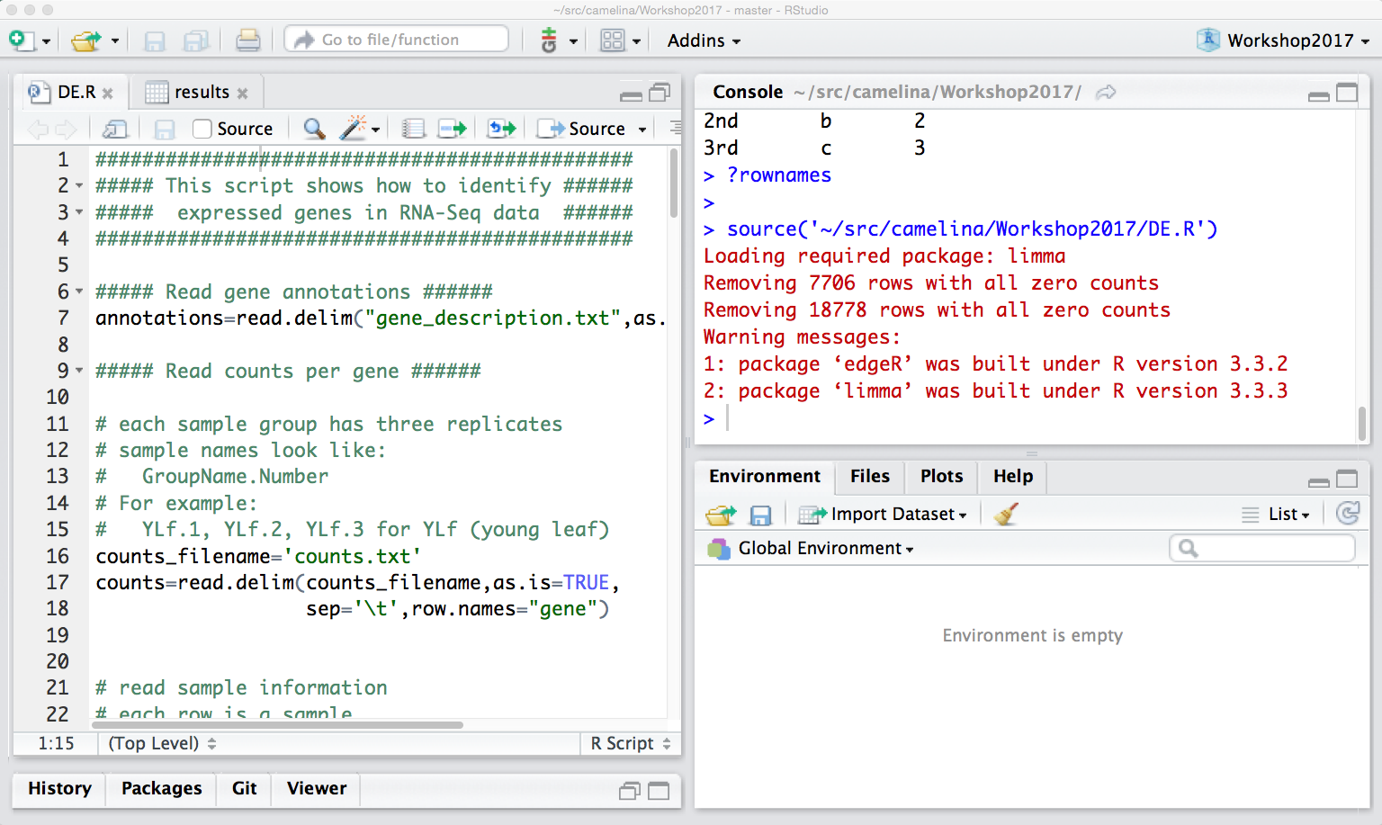
A script is a program that contains commands designed to run in a sequence, from top to bottom
Clicking Source button runs the entire file
# is the comment character
anything after a comment character is not R; it's free text that typically explains the code
write comments to explain the code
Click broom button to start over
You can run the entire file by clicking the Source button.
Today, run the file line by line to learn individual steps.
If you used Source to run the entire file, that's OK. Just click the broom button in the Environment tab to start over.

Slide 17
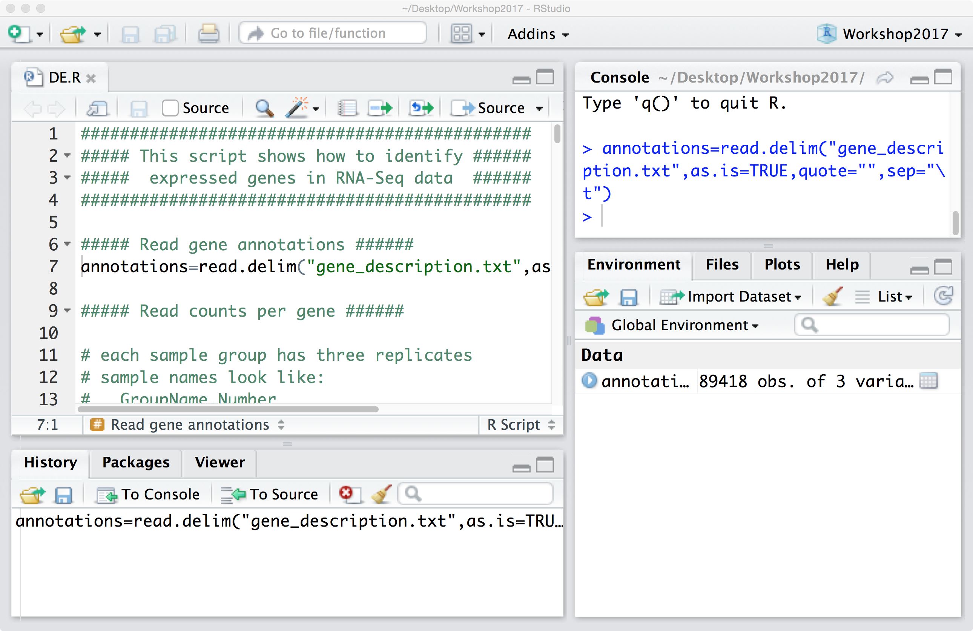
Today, run code line-by-line from editor
Command prints to Console
Place cursor next to line of code, type CONTROL-RETURN to run the command
Newly defined variable appear in Environment tab
Or COMMAND-RETURN on Mac
Or click the Run button

Slide 18
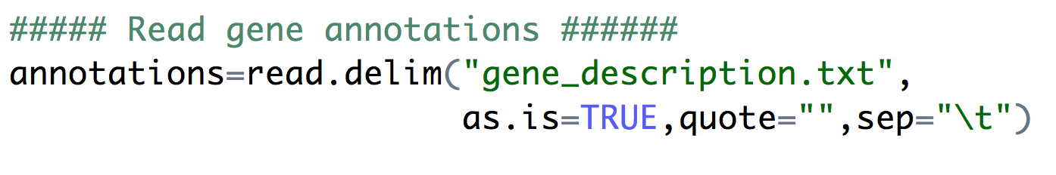
First R command in the script: Read gene information from gene description file using read.delim
read.delim accepts a file name, returns a data frame
Has many options for diverse file formats
  as.is - ensures text are read as character data (not as factors - categories)
  quote - set to empty string (""); ignore all quotation marks
  sep - field separator; "\t" is code for TAB
Data cleaning is often the most challenging part of data analysis.

Slide 19
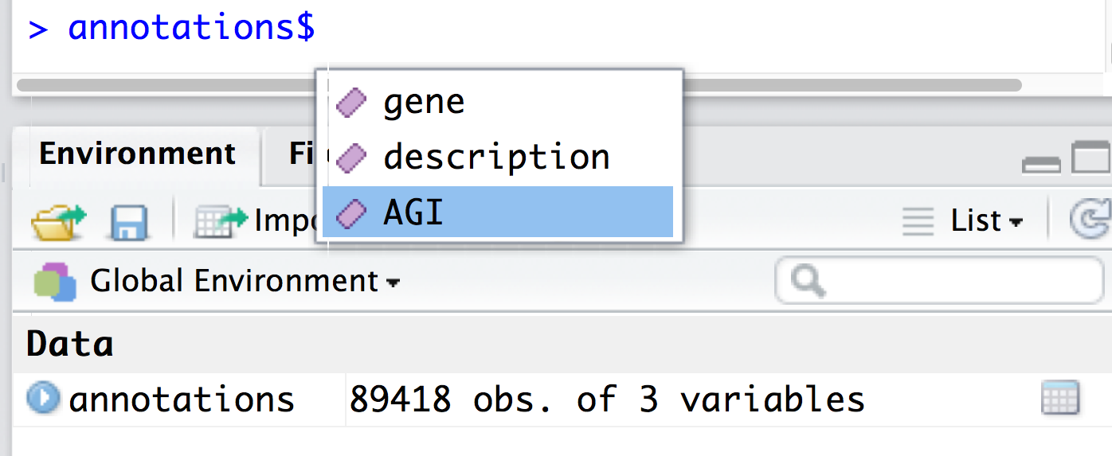
annotations is a data frame
Use $ to access column names
Type variable name and $
  RStudio shows the columns
Kagale et al identified three Arabidopsis counterparts for most Camelina genes. Camelina is hexaploid - "Arabidopsis times three."

Slide 20
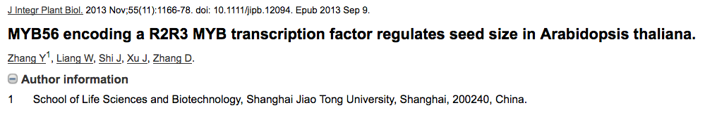
Use grep to look up Camelina homeologs of Arabidopsis genes
> gene="AT5G17800"
> index=grep(gene,annotations$AGI)
> annotations[index,]
gene description AGI
32135 Csa08g010050 myb domain protein 56 AT5G17800
57252 Csa13g020620 myb domain protein 56 AT5G17800
86541 Csa20g025980 myb domain protein 56 AT5G17800

Slide 21
Next: Import counts per gene into R using read.delim
Reminder:
Columns are samples (libraries)
Rows are genes.
Values are counts per genes.
One "count" is a pair - Read1 and Read2 sequenced from the same library molecule.

Slide 22
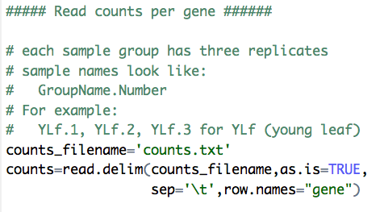
Use read.delim to read counts per gene data into your R environment
same options as before, plus row.names
row.names - tells R to assign row names using values in the genes column

Slide 23
Columns are libraries, rows are genes, values are fragment counts per gene
Use dim to count rows & columns
Use names to view column names
> dim(counts)
[1] 89418 36
> names(counts)
[1] "GrS.1" "GrS.2" "GrS.3" "Cot.1" "Cot.2" "Cot.3" "YLf.1" "YLf.2"
[9] "YLf.3" "SLf.1" "SLf.2" "SLf.3" "Stm.1" "Stm.2" "Stm.3" "Roo.1"
[17] "Roo.2" "Roo.3" "Bud.1" "Bud.2" "Bud.3" "Flw.1" "Flw.2" "Flw.3"
[25] "ESD.1" "ESD.2" "ESD.3" "EMD.1" "EMD.2" "EMD.3" "LMD.1" "LMD.2"
[33] "LMD.3" "LSD.1" "LSD.2" "LSD.3"
GrS - Germinating seed
Cot - Cotyledon
YLf - Young Leaf
SLf - Old (senescing) leaf
Stm - Stem
Roo - Root
Bud - Bud
Flw - Flower
ESD - Early seed development
EMD - Early mid seed development
LMD - Late mid seed development
LSD - Late seed development

Slide 24
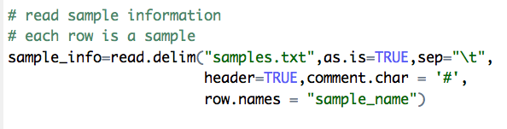
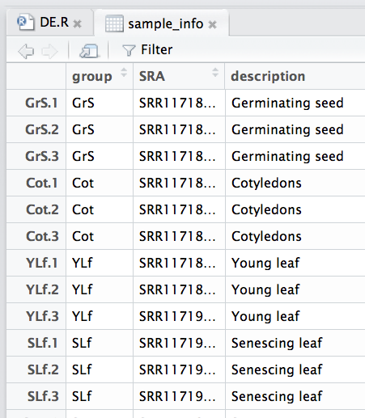
Use read.delim to read sample information
sample_info - a data frame with 36 rows, a row for each column in counts
View it in RStudio data browser

Slide 25
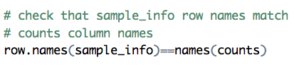
Use == operator to double-check that the columns in counts match the rows in sample_info
Tip: use sum to count the number of TRUE values in a logical vector:
  v = row.names(sample_info)==names(counts)
  sum(v)

Slide 26
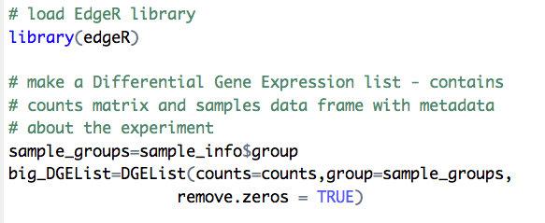
Load edgeR library and create a DGEList
Use remove.zeros argument to only consider genes that had at least one count in at least one sample.
  How many genes had zero counts in every sample?
DGEList - a kind of list; a differential gene expression (DGE) list

Slide 27
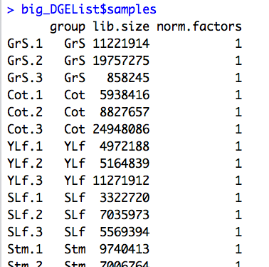
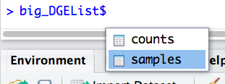
big_DGEList is a list that contains a matrix (counts) & a data frame (samples)
Access these elements using $ operator
big_DGEList$counts - counts data frame transformed into a matrix
big_DGEList$samples - a data frame with meta-data about the experiment
    big_DGEList$samples$lib.size - counts per library

Slide 28
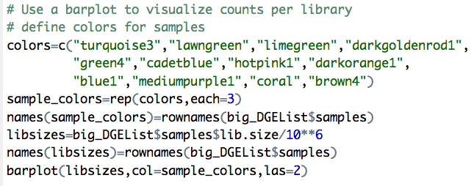
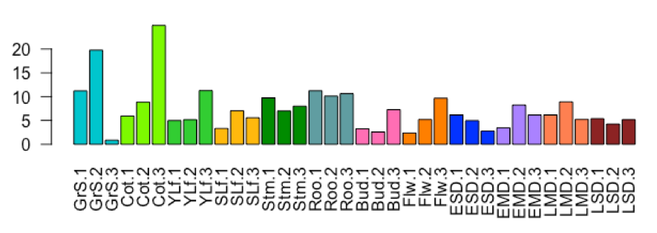
Use barplot and samples data frame (from big_DGEList) to visualize sequencing depth
bar heights show read counts divided by a million

Slide 29
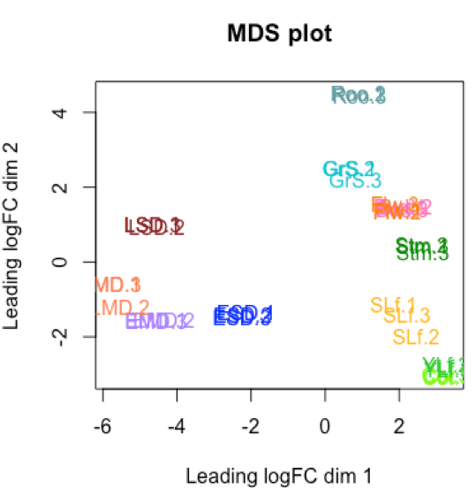
Use plotMDS to visualize sample relatedness
Samples with similar expression are closer.
Replicates should be closest.

Slide 30
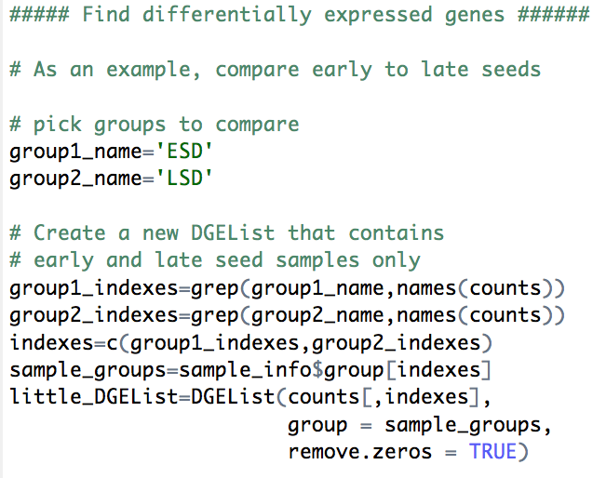
Find differentially expressed genes - compare early and late seeds
Make two variables with the sample group names
Make a new DGEList object with just those sample types
Note: many more zero-count genes removed

Slide 31
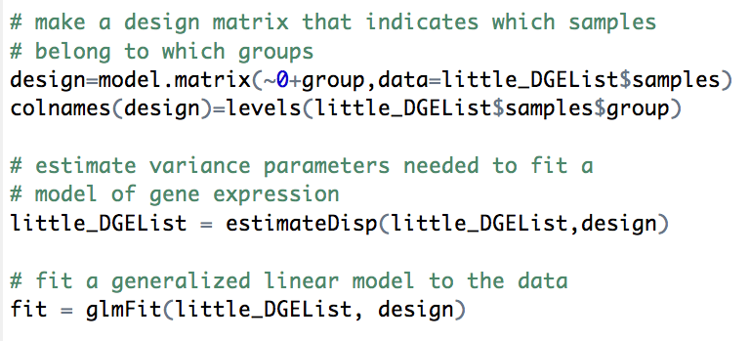
Fit linear model to the data - needed for statistical testing
The design object tells R which samples belong to the two different groups
The fit object expresses gene expression as coefficients of a linear model.

Slide 32
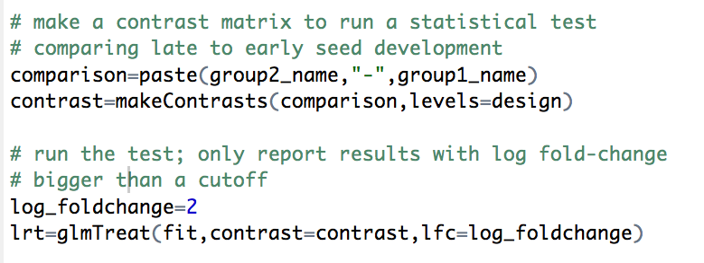
Find DE genes where ratio between treatment and control is four-fold or greater
contrast - specifies the comparison.
glmTreat - tests each gene for differential gene expression, focusing on genes where fold-change > 4 (log fold-change > 2)

Slide 33
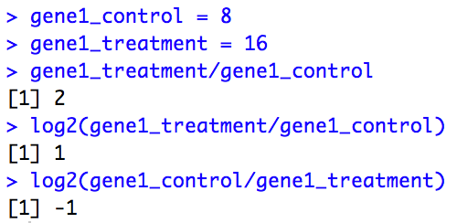
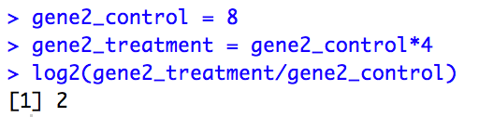
logFC is the logarithm (base 2) of the ratio of gene expression in the compared samples
For each gene, divides expression in the treatment by expression in the control, then take the log base 2
  We are thinking of seed maturation as the treatment
Use the log (base 2) because the sign captures the direction
  positive logFC means treatment increased expression
  negative logFC means the treatment decreased expression
  the absolute value of the logFC tells you the magnitude of the change

Slide 34
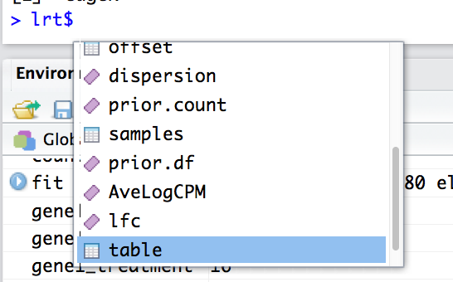

lrt object - another list-like object (class "DGELRT") with many elements
Use $ operator to access its elements
The table element contains results
Set that equal to a new variable results

Slide 35
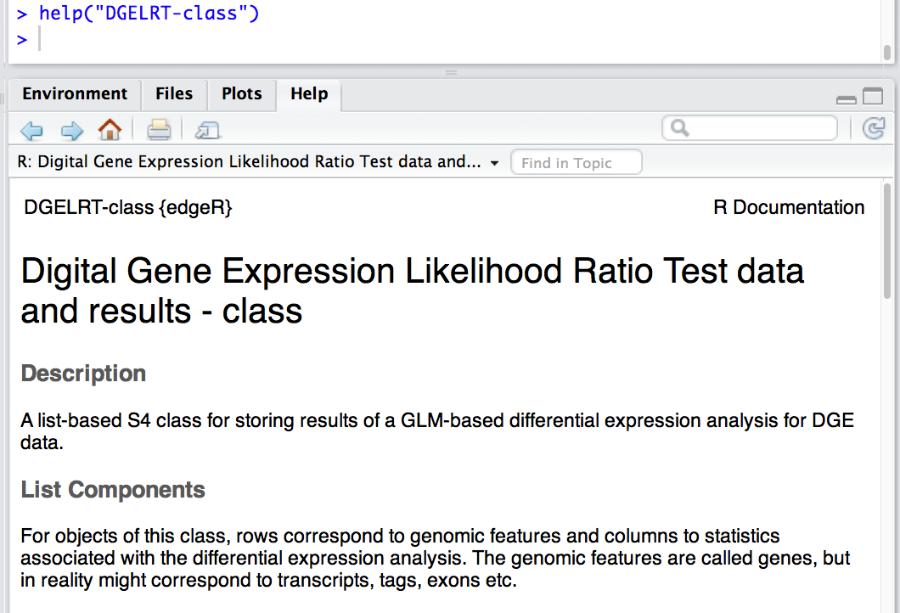
For more information about the lrt object, view documentation using help

Slide 36
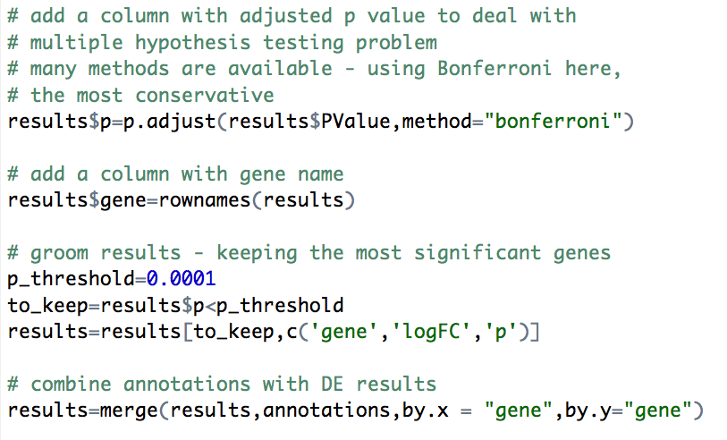
Groom results - add adjusted p value, functional annotations

Slide 37
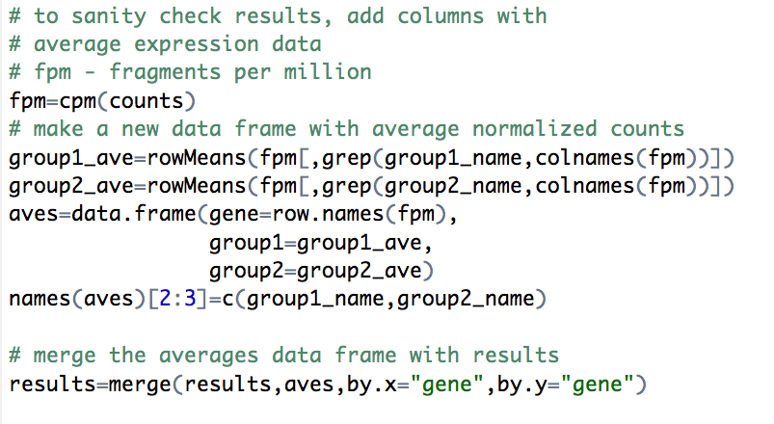
Groom results - add average expression per group for sanity checking

Slide 38
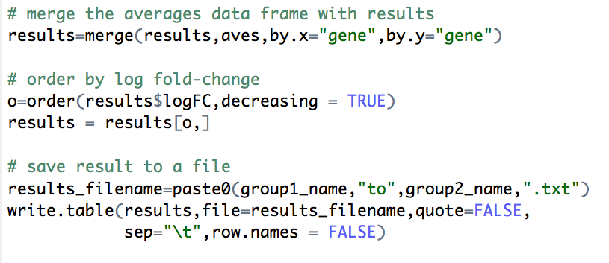
Groom results - order rows by logFC (from high to low), then save to a file

Slide 39
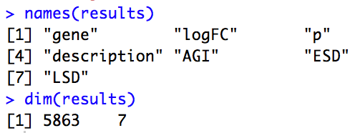
How many genes were differentially expressed in this comparison?
Using the fold-change and p value thresholds, which are a bit arbitrary, we found 5,863 DE genes

Slide 40
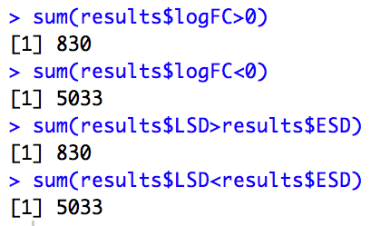
How many genes were up- or down-regulated?
Tip: When passed a logical vector, sum reports the number of TRUE values
Expression of 830 genes increased during seed development.
Expression of 5,033 genes decreased during seed development.

Slide 41
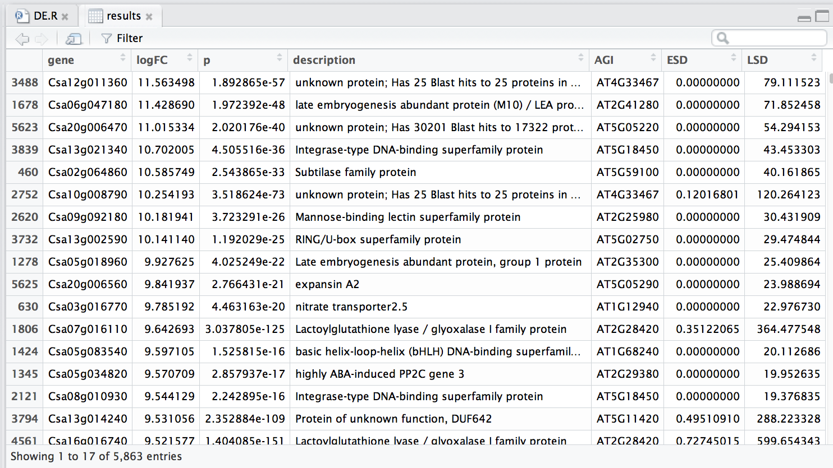
Explore results - view in RStudio

Slide 42
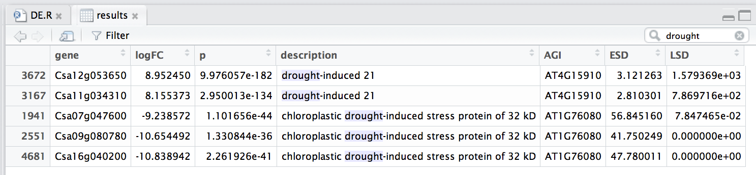
Explore results - search "drought"
Let's focus on the first result:
  gene name: Csa12g053650
  gene description: "drought-induced 21"
  Arabidopsis homolog is AT4G15910 (google for more info)

Slide 43
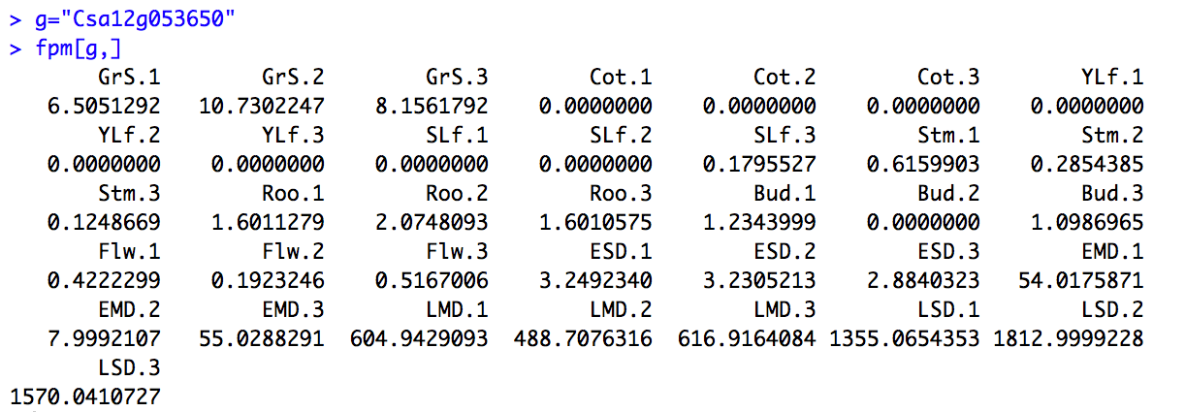
Look at expression in all the samples (not just late and early seeds)
Looking at just the numbers:
Can see what looks like increase during seed development, but low in germinating seed

Slide 44
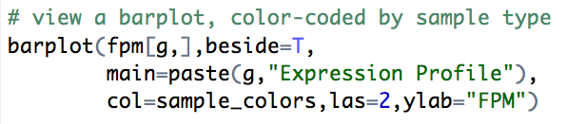
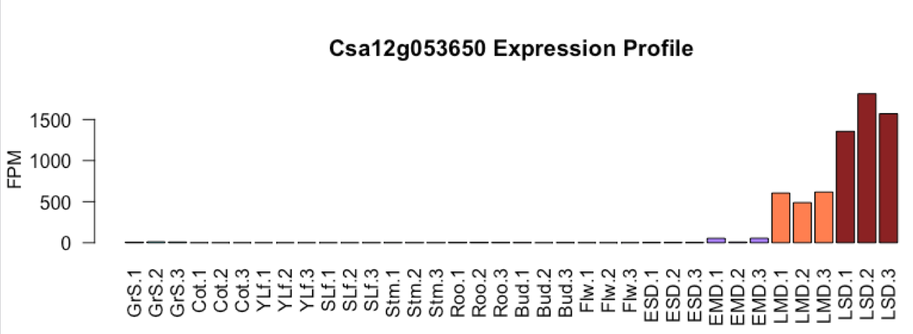
Visualize expression profile using barplot

Slide 45
You try it! (and then take a break)
Compare two other samples
  Tip: Change group1_name and group2_name, and use Source button to re-run the file
How many genes were DE?
How many were up or down regulated?

Slide 46

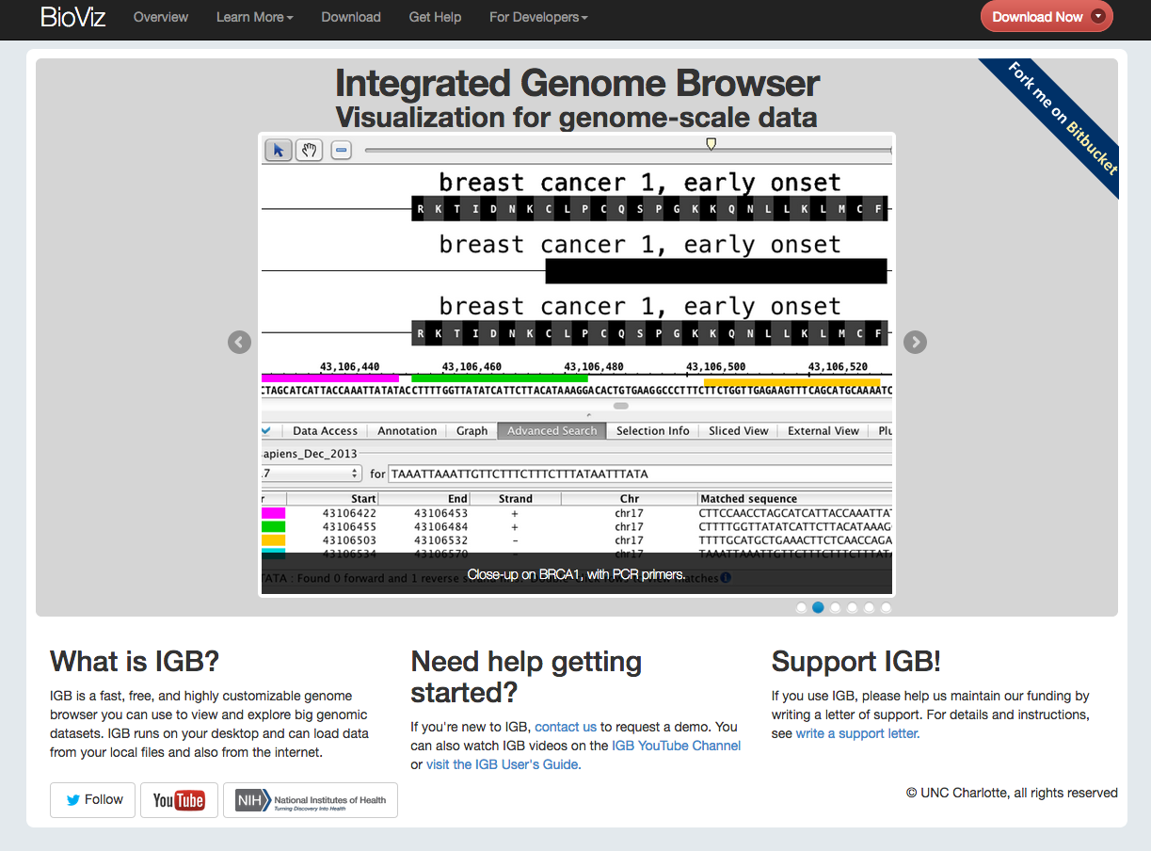
Visualize expression data using Integrated Genome Browser browser
Integrated Genome Browser - free from BioViz.org
Notes:
Integrated Genome Browser is free from BioViz.org. You can get an installer for your platform by clicking the download links!

Slide 47
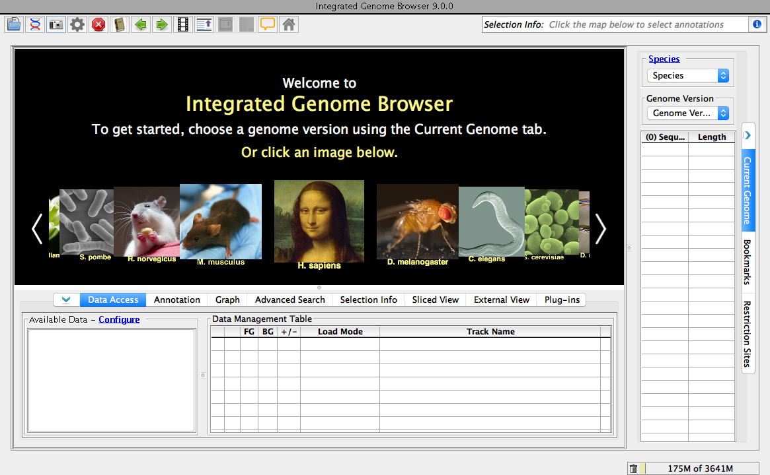
Select Camelina sativa
Notes:
When you start IGB, you'll see the IGB "Start screen." The images are shortcuts to frequently used genomes. To go to the Camelina genome, use the Species menu.

Slide 48
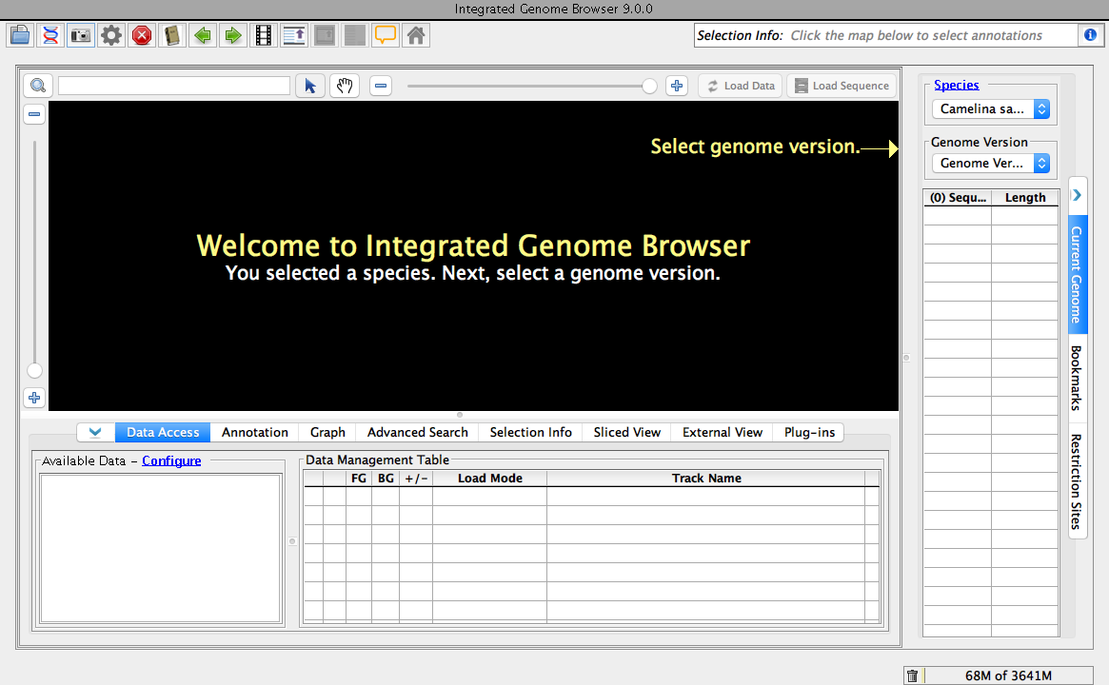
Select April 2014 genome version
Notes:
Next, select the latest Camelina genome. There's only one genome release from April 2014.

Slide 49
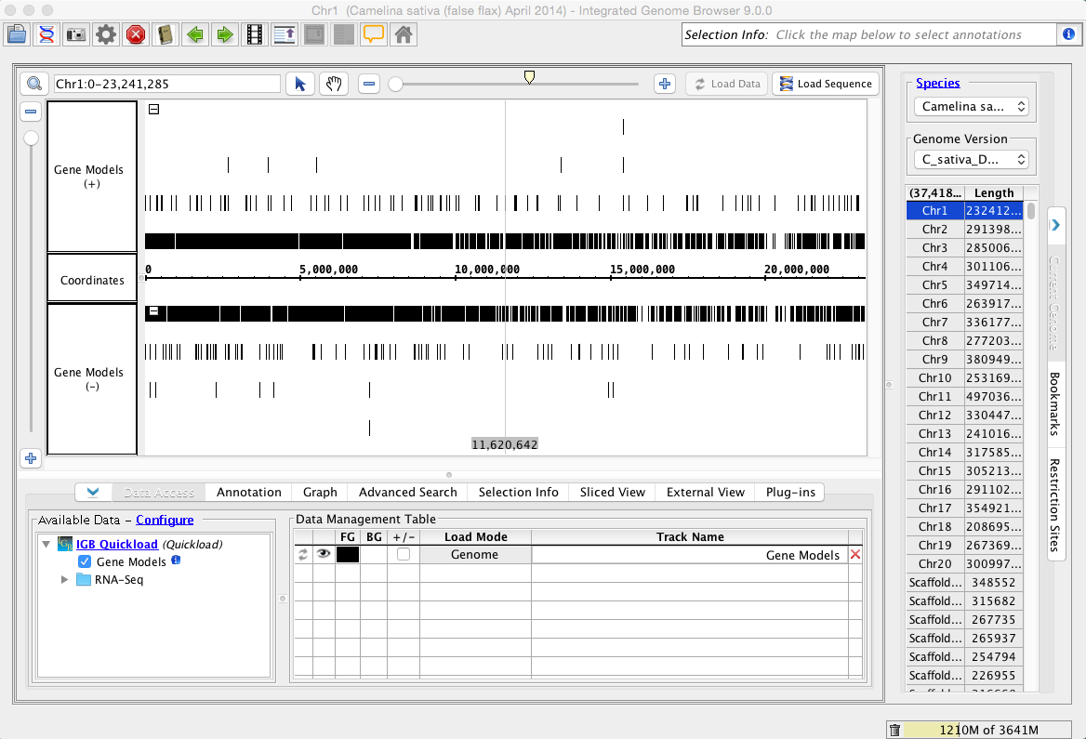
Forward strand gene models
Reverse strand gene models
Gene models also load automatically.
Can take a few seconds depending on network.
Plus strand gene models load above the axis, minus strand models load below it.

Slide 50
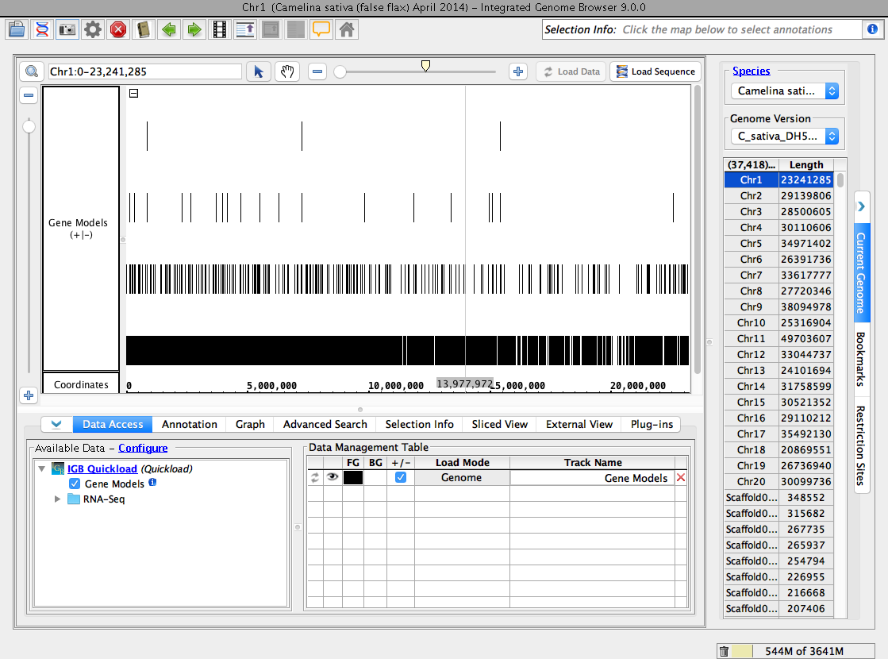
IGB has bottom and side tabbed panels with many features and controls.
Today you are learning about:
Current Genome
Data Access
Annotation
Graph
Advanced Search

Slide 51

Current Genome tab (right side) lists chromosomes and scaffolds in 2014 genome release.
Note how this genome release lists 20 chromosomes and more than 30,000 unanchored scaffolds!
You can switch between chromosomes by clicking rows in the table.
Note: Stay on Chr1 (the default when IGB opens this genome)

Slide 52

Use "V" buttons to open & close tabbed panels.
Close the side tabs to make more room to visualize data on your laptop screen.

Slide 53


Select Annotation tab.
Click-drag divider to show entire tab.

Slide 54

Click track label to activate Annotation tab options.
Change Strand setting. Click "+/-" to combine forward & reverse strand tracks.

Slide 55

Now forward and reverse strand are in one track.
Click "V" to retract tabs and make more room to view data.

Slide 56
IGB has many ways to move & zoom
Animated zooming
  click to position zoom stripe, sets zoom focus
  horizontal zoom & vertical stretch
Moving from side to side (panning)
  arrows in toolbar
  hand icon - the move tool
Jump-zooming
  Click-drag coordinate axis with arrow tool
  Double-click to zoom in on a feature
  Search by name

Slide 57


Practice: Zoom to alternatively spliced gene models
Drag slider to zoom in
*
Click to set the zoom focus. Aim for the spot above the four gene models in a stack.
Gray line is the zoom stripe. It focuses zooming. When you zoom, it stays in place while the display stretches or contracts on either side. It also serves as a ruler to compare boundaries.

Slide 58

Notice how zoom stripe did not move during the zoom.

Slide 59

Practice: Click-drag axis to jump-zoom
1. Select arrow tool
2. Click coordinates axis.
3. Drag right and release.

Slide 60

Practice: Double-click a label to zoom in
1. Double-click gene model label.

Slide 61

Red outline shows selected gene model.

Slide 62

Gene model - a hypothesis about how transcription and splice happen at a locus
5' UTR
3' UTR
intron
exon
Taller rectangles indicate translated regions.

Slide 63

1. For more information about the selected model, click "i" button
Selected gene model

Slide 64

This alternatively spliced gene encodes a putative splicing factor.

Slide 65

2. Select move tool (hand) and click-drag display to move up or down, side to side
1. Drag vertical slider to zoom vertically
3. Double-click the label to go back.

Slide 66
1. Click Load Sequence to load genomic sequence.

Slide 67


Sequence loads below coordinates axis

Slide 68


Choose arrow tool
Click-drag axis to jump-zoom to the beginning of the translated region.

Slide 69

Zooming in displays nucleotide and amino acid sequences.

Slide 70

Double-click gene model label to zoom out.
Select Data Access tab to open Data Access tabbed panel.

Slide 71

Available Data lists data you can load from the IGB Quickload data server.

Slide 72

Open RNA-Seq folder
Reads - mRNA-Seq sequence alignments
Graph - coverage graphs
Junctions - summarized reads aligning across intron junctions (for splicing analysis)
From Kagale et al (2014)
Camelina genome paper

Slide 73


12 sample types, 3 replicates per sample type
Click "i" to access Quickload server with data files
Bud - Buds
Flw - Flowers
ESD - Early Seed Development
EMD - Early Mid Seed Development
LMD - Late Mid Seed Development
LSD - Late Seed Development
GrS - Germinating seed
Cot - Cotyledons
Stm - Stem
YLf - Young leaf
Roo - Root
Slf - Senescing leaf

Slide 74

Open the Graph folder under Available Data
Click ESD.1 just once! Wait for new track (gray bar) to appear.
Then, click LSD.1 just once! Wait for new track (gray bar) to appear.

Slide 75
To load data (and fill in the gray) click Load Data
Wait a few seconds for the data to load (it's coming from far away!)

Slide 76

These are genome coverage graphs
Y-axis shows the number of reads aligning to base pair positions on the x axis

Slide 77
Not much coverage here
Looks like Variant #2 is most highly expressed isoform.
Minimal (if any) differential expression between sample types.

Slide 78


Select Advanced Search tab.
Enter description text from differentially expressed gene from the R session: "drought-induced 21"
Type RETURN (or click magnifying glass button )

Slide 79

The search returns three genes.
Recall that Camelina is hexaploid.
These are homeologs.

Slide 80
Double-click the 3rd result row (Csa12g053650)

Slide 81

Note how double-clicking a result row takes you to the that gene's location.
Graph tracks are gray because you have not yet loaded data in this region.

Slide 82
Practice your IGB skills:
Zoom out to show other genes in the region.
Hide the bottom tab (click "V" button).
Click Load Data to load coverage graph data.

Slide 83


Notice the difference in gene expression.
Open the Graph tab - let's put the graphs on the same scale.

Slide 84

Rescaled graphs - showing 0 to 4,000 reads/base.
Click Select All to select both graphs.
Use the slider or text box under Y Axis Scale to set the maximum y-value for both graphs at the same time.

Slide 85
Tip: Click the Stack Height toolbar button to get rid of white space in the gene model track.
Click button to zoom in and show gene model label.
Click near the model to re-focus zooming (if necessary)
Hide the bottom panel tabs to make more room for data.

Slide 86

Click Camera button in Toolbar to save an image.
Try it on your own:
Look for another gene
Load other tracks?

