Slide 1
Two-sample paired & unpaired t test
Comparing two groups

Slide 2
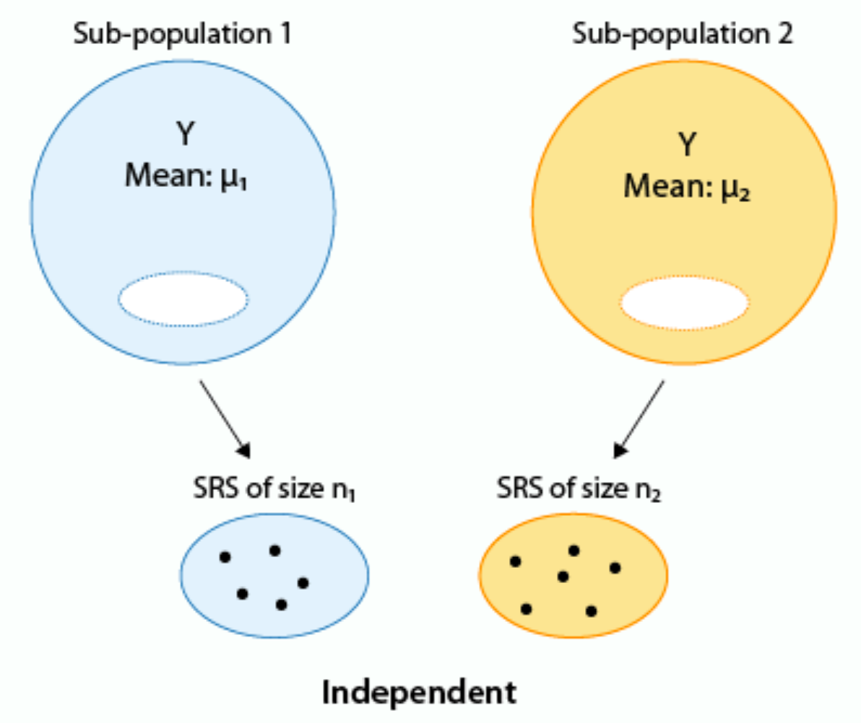
Categorical variable distinguishes groups. A two-sample t-test asks: are the means are different?
yellow
blue
Example: A certain kind of plants produces flowers in many colors, including blue and yellow. Is there are a difference in the sizes of seeds produced by blue versus yellow flowers? To find out, we take two random, independent samples of seeds and measure them.

Slide 3
Example data
seeds from blue flowers:
19.0, 18.8, 19.1, 18.7, 17.9
seeds from yellow flowers:
19.4, 20.1, 20.3, 20.4, 20.9
R:
Make two vectors - call them blue and yellow - with above values
Use "c" operator to enter data

Slide 4
Example data
seeds from blue flowers:
19.0, 18.8, 19.1, 18.7, 17.9
seeds from yellow flowers:
19.4, 20.1, 20.3, 20.4, 20.9
R:

Slide 5
State null & alternative hypothesis
H₀ - means are the same, so difference of means is zero
μ_{blue} - μ_{yellow} = 0
H_{A} - means are different, difference is non-zero
μ_{blue} - μ_{yellow} ≠ 0
Alternative hypothesis is two-sided
we want to know if seeds have different size or not

Slide 6
How to use two-sample t-test
Confirm samples are independent
Confirm data are normally distributed
Calculate t test statistic
Compare to t distribution with degrees of freedom that matches your data
Df = number of values in the first group + number of values in the second group - 2
Recommend: use t.test in R

Slide 8
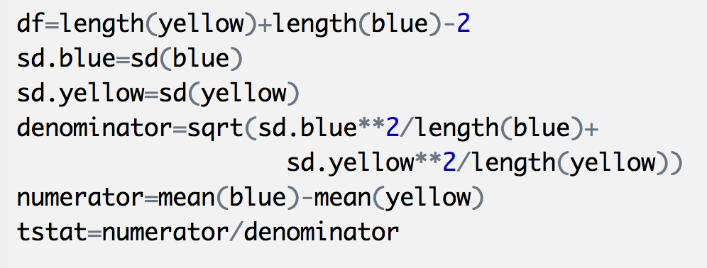
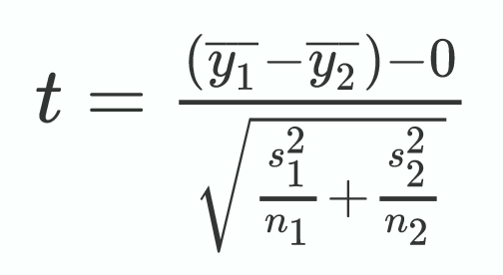
Practice: Use R to calculate t test statistic
You should get

Slide 9
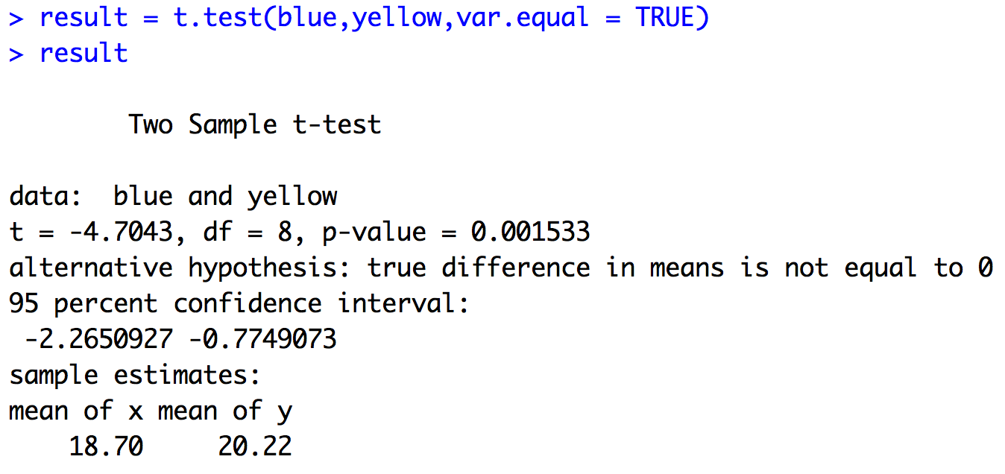
Practice: Use t.test to perform two sample t-test
Set to TRUE you think
variance of two
groups is similar
Probability of obtaining difference
of means as extreme under the null
hypothesis.
CI for the difference of means.
Note 0 not in this interval.

Slide 10
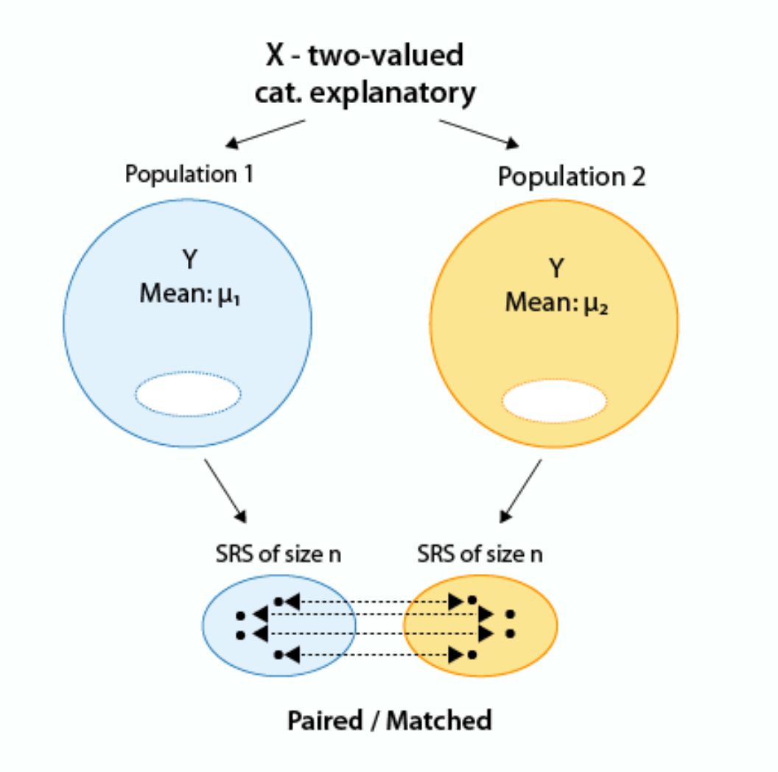
Matched pairs; samples not independent; use paired t-test

Slide 11
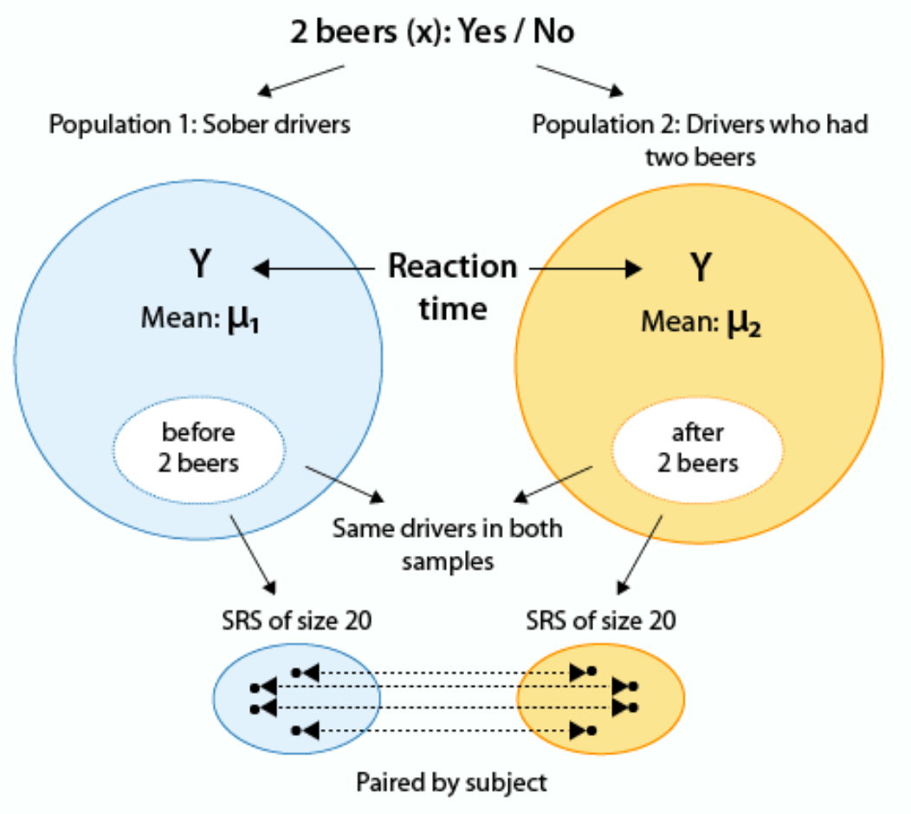
Testing difference between driver's
reaction time and after having
two beers.
Is reaction time the same, or longer?

Slide 12
Null & alternative hypotheses
H₀: μ_{d} = 0 (Reaction time is the same after two drinks)
H_{A}: μ_{d} > 0 (Reaction time is longer after two drinks)
where μ_{d} = after - before

Slide 13
Practice: t.test in R
Get the data from Canvas
Read into R (tip: can use Tools > Import Data Set)
Check whether the differences vary normally
use a histogram
Compare "Before" and "After" using t.test with paired option
one-sided; testing that After is longer than Before

Slide 14
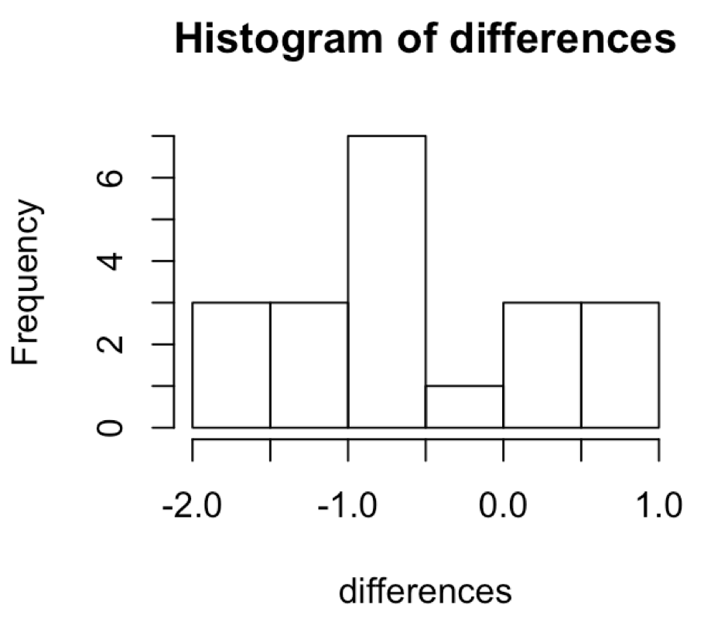
Do differences vary normally?
Make a new vector with differences
Visualize using histogram

Slide 15
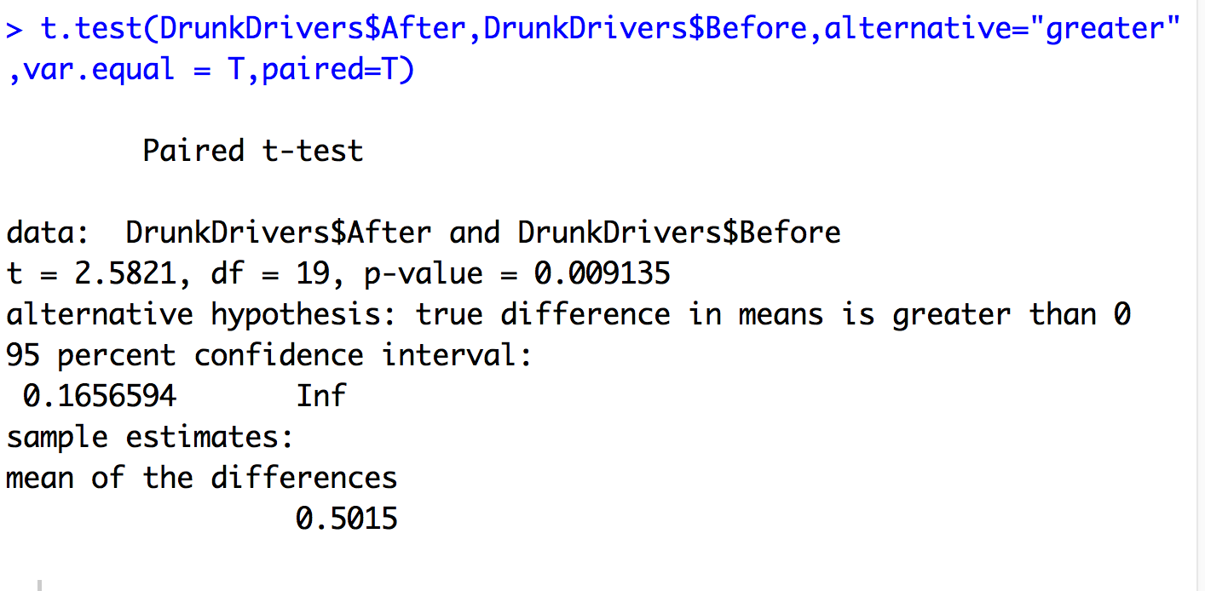

Slide 16
Notes:
https://lagunita.stanford.edu/courses/OLI/ProbStat/Open/courseware/inference_relationships_cq/_m3_matched_pairs/
unit 3

Slide 17
Notes:
https://lagunita.stanford.edu/courses/OLI/ProbStat/Open/courseware/inference_relationships_cq/_m3_matched_pairs/
unit 3

Slide 18
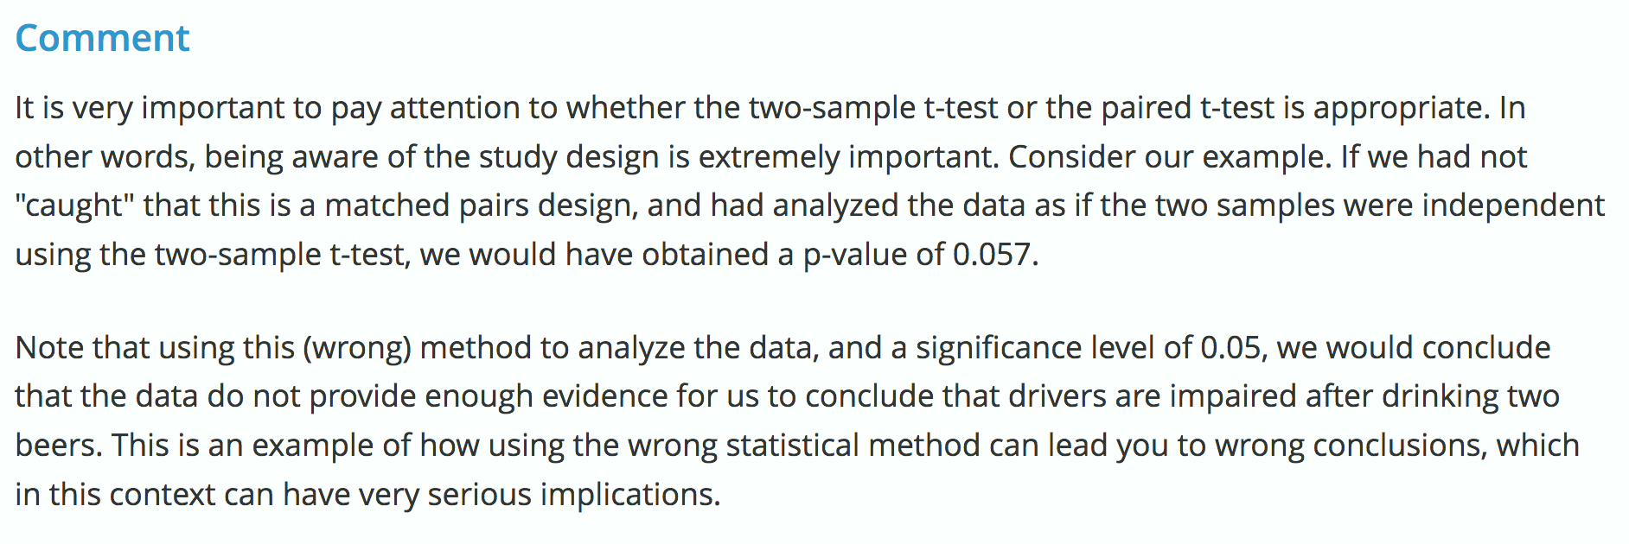
Matched versus unmatched two-sample t test
Why does the matched t test produce a smaller p value?
Notes:
https://lagunita.stanford.edu/courses/OLI/ProbStat/Open/courseware/inference_relationships_cq/_m3_matched_pairs/
unit 5

Slide 19
Practice - on your own
Download data set
Read into R
If samples size < 30, visualize data
make sure that there are no signs of non-normality like extreme skewedness and/or outliers
State null and alternative hypotheses
Perform test
Do you reject the null, or not?

